Slide 1
Student Education Service
Welcome
Questions & Answers

Slide 2
Welcome from the Student Education Service
We will keep everyone’s microphones off to reduce noise issues
This presentation will be recorded and available to rewatch on the LUBS Student Guide, but the Q&A at the end will not be
Please do not raise your hand, we will not be using this function today.
You can ask questions at the end by using the chat function.
Use emojis in the chat to let us know:
How are you feeling about this academic year?

Slide 3
The information we will cover
Introduction to the Student Education Service (SES)
Student Information Service
LUBS Student Support
LUBS Student Guide
In-Sessional Language Support
Student Reps
PASS – Peer Assisted Student Sessions
Joint Honours Community
Q&A in the chat

Slide 4
Student Education Service – who are we?
The Student Education Service consists of various teams, all dedicated to assisting you throughout your student journey, from registration to graduation!
Academic Life
Exams and Assessment
Programme Support
Digital Learning
Health and Wellbeing
Opportunities

Slide 5
Student Information Service
Telephone
Our Helpline Team are on hand Monday to Friday 9-5 pm.​
Call +44 (0)113 343 7000 (outside the UK)​
Call free phone 0800 915 0402, at no charge​ (within the UK)
Email
studentinfo@leeds.ac.uk
In-Person
Our Information Points are open from 9am to 5pm Monday to Friday.
Beech Grove House campus map link | Google map link
Chemical and Process Engineering campus map link | Google map link
Maurice Keyworth building campus map link | Google maps link
Parkinson Building campus map link | Google map link
Worsley building campus map link | Google map link

Slide 6
General Queries
The answer to most general queries can be found at

Slide 7
Business School Student Support Team
We can advise on
Support and options available for if your studies are affected by any mitigating circumstances
Signposting to other support and services
Support available for disabilities whilst studying
Taking temporary leave from studies

Slide 8
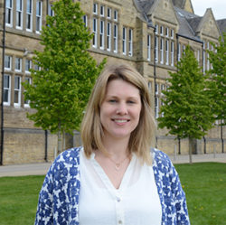
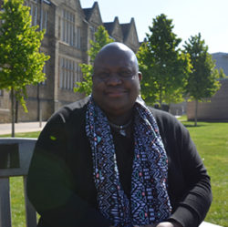
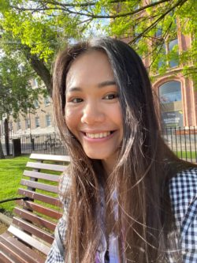
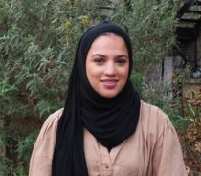
Student Support Officers
You can find out more information on how to book an appointment with one of our Student Support Officers on the LUBS Student Guide:​
​https://students.business.leeds.ac.uk/student-support/booking-and-appointment/
Our team offer appointments every day, and a mixture of in-person and online appointments

Slide 9
LUBS Student Guide

Slide 10
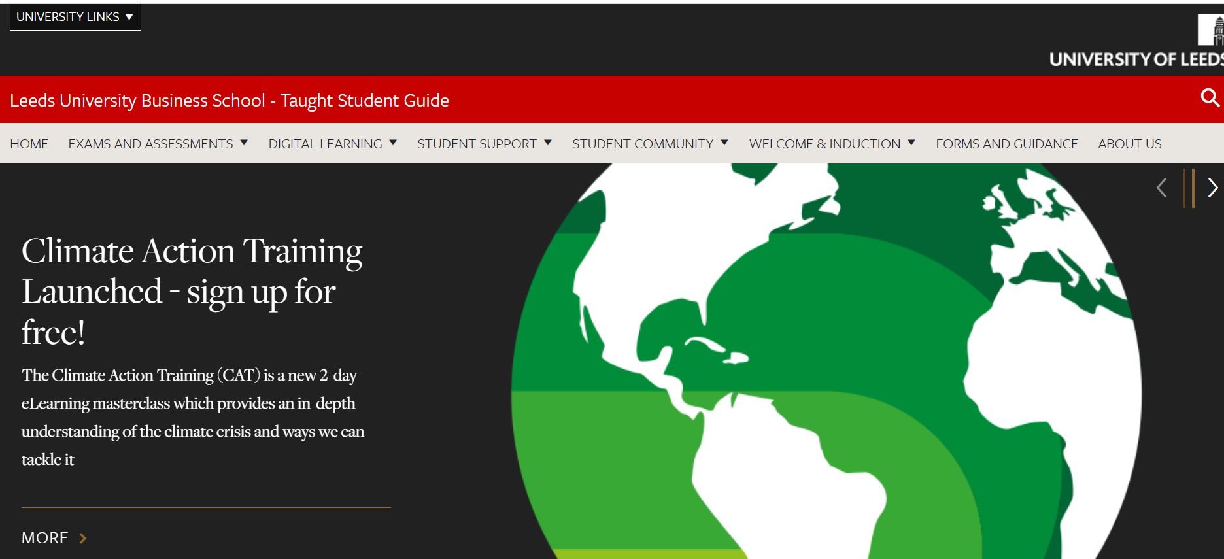
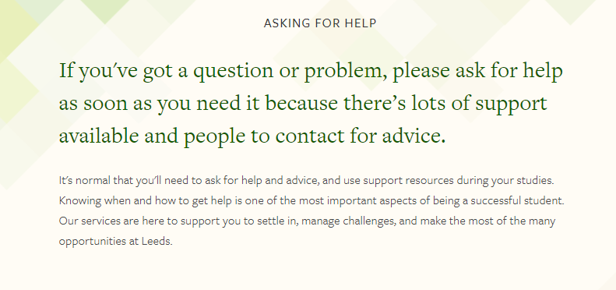
LUBS Student Guide
You can find a lot of information on the main University website and on our LUBS Student Guide.
https://students.business.leeds.ac.uk/
https://students.leeds.ac.uk/askingforhelp

Slide 11
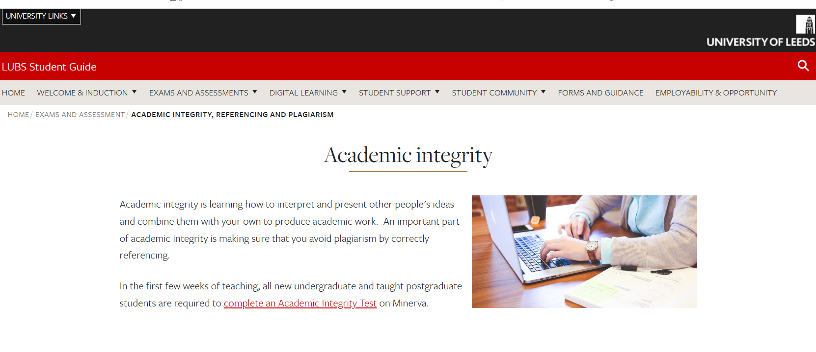
LUBS Student Guide
Action: complete the Academic Integrity Test on Minerva.​
​
The link is on the Academic Integrity page in your online induction pack.

Slide 12
In-sessional language Support
In-sessional EAP (English for Academic Purposes) sessions take place during student’s programmes.
Watch the 10-minute video to get a better understanding of how the in-sessional EAP programme is different from General English and study skills, and whether this programme might be relevant to you.​
​
The video is on the LUBS Student Guide as part of your Business School Welcome & Induction.

Slide 13
Student Representatives
Course Representative
Represent students on a particular course.
Seek student opinions to enact positive change.
Share feedback with staff and School Representatives.
Recruited by the Business School.
School Representative
Represent students in entire Business School.
Seek student opinions from Course Representatives to enact positive change.
Provide link between staff, students, and Leeds University Union.
Recruited by the Leeds University Union.

Slide 14
Become a Course Representative
Improve your employability
Receive accreditation and recognition for your commitment
Be eligible for Rep-specific awards as part of Celebrate Week
Work in partnership with Business School staff and students
Network with other Course Representatives
Approx. 1 hour a week.
How to apply:
Visit students.business.leeds.ac.uk
Deadline to apply: 11.59pm, Monday 9th October 2023

Slide 15
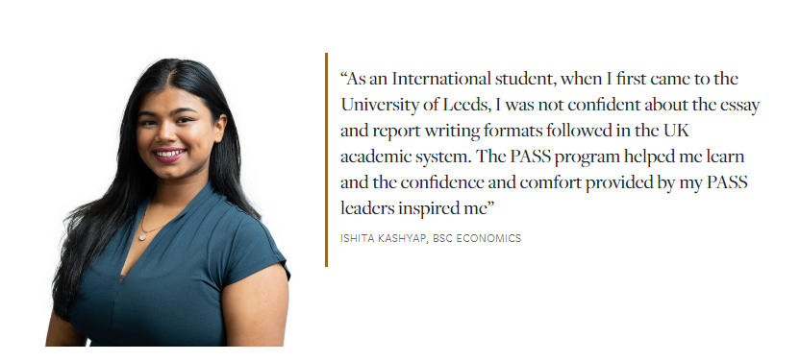
Peer Assisted Study Sessions
What is PASS?
A Mentoring scheme for first year students.
PASS study sessions are every two weeks.
Sessions are led by trained 2nd and 3rd year students (your PASS Leaders).
How will PASS help me?
Use your Leader’s expertise to develop your own skills.
Bring topics to the session you’d like to know more about.
Want to know more?
Search for “PASS” on: students.business.leeds.ac.uk

Slide 16
Joint Honours Community
Join our Joint Honours Community! Visit us in the Marquee (opposite the Union) Tuesday 3rd October 12pm – 2.30pm
Benefits of joining
Meet other Joint Honours students
Top tips for getting the most out of your degree and time at Leeds
Get your voice heard
Sign up to future activities and events
Free drinks, cake and sweets

Slide 17
Who to contact when
Student Information Service Studentinfo@leeds.ac.uk
For any general questions about University life
LUBS Student Support LUBSStudentSupport@leeds.c.uk
Student wellbeing concerns, mit circs, temp leave
LUBS Assessment LUBSAssessment@leeds.ac.uk
For any assessment related questions or problems, such as issues with submitting your work
LUBS Attendance LUBSAttendance@leeds.ac.uk
Any attendance or absence related issues or questions, late arrivals, change of location
LUBS Programme Support / Quality LUBSQuality@leeds.ac.uk
Module enrolment / changes, programme changes, programme queries, academic integrity

Slide 18
Common Questions
Remember to check University webpages first for quick answers to questions
Accommodation
accom@leeds.ac.uk &
https://accommodation.leeds.ac.uk/
Fees and Funding
UGfees@leeds.ac.uk &
https://www.leeds.ac.uk/undergraduate-fees/doc/fees-undergraduate-fees
Registration
https://students.leeds.ac.uk/info/10102/registration/1056/how_to_register

Slide 19
Common Questions
Remember to check University webpages first for quick answers to questions
Module Change
https://students.leeds.ac.uk/info/10104/making_changes/652/change_of_module
How to use Minerva
https://students.business.leeds.ac.uk/digital-learning/new-students/
BRP
https://students.leeds.ac.uk/brpcollection
International Student Arrivals
https://www.leeds.ac.uk/info/130113/preparing_for_leeds/112/arriving

Slide 20
Common Questions
Remember to check University webpages first for quick answers to questions
IT Support
https://it.leeds.ac.uk/it
Library services
https://library.leeds.ac.uk/
Leeds University Union (LUU)
https://www.luu.org.uk/

Slide 21
Questions

