Slide 1
We will start the session at 12:05
Please make sure that your mobile phone is nearby because we may use it for interactive activities.
If you have questions during the session, please raise your hand or you can leave your questions in the Padlet by using the QR code on the right. We will check the Padlet sporadically during the lecture.
Notes:
No one needs to present this slide as it is self-explanatory.

Slide 2
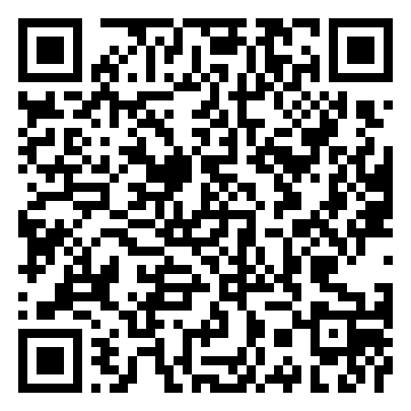
Please record your attendance by scanning the QR Code:
https://mycareer.leeds.ac.uk/unauth/attend/EVENT_SLOT/0d5368a1-876f-4180-92da-9a8998ffeea7
Notes:
Tao will introduce this slide

Slide 3
Team & Me Competition (2023-24)
Chris Hoy, Deputy Manager (LUBS Employability & Opportunity team)
Tao Jiang, Faculty Director of Student Opportunity, Experience and Success
Caroline Williams, Manager (LUBS Employability & Opportunity team)
Notes:
Tao will start the session and introduce staff members while leading onto the icebreaker activity.

Slide 4
Notes:
Caroline will run icebreaker activity.

Slide 5
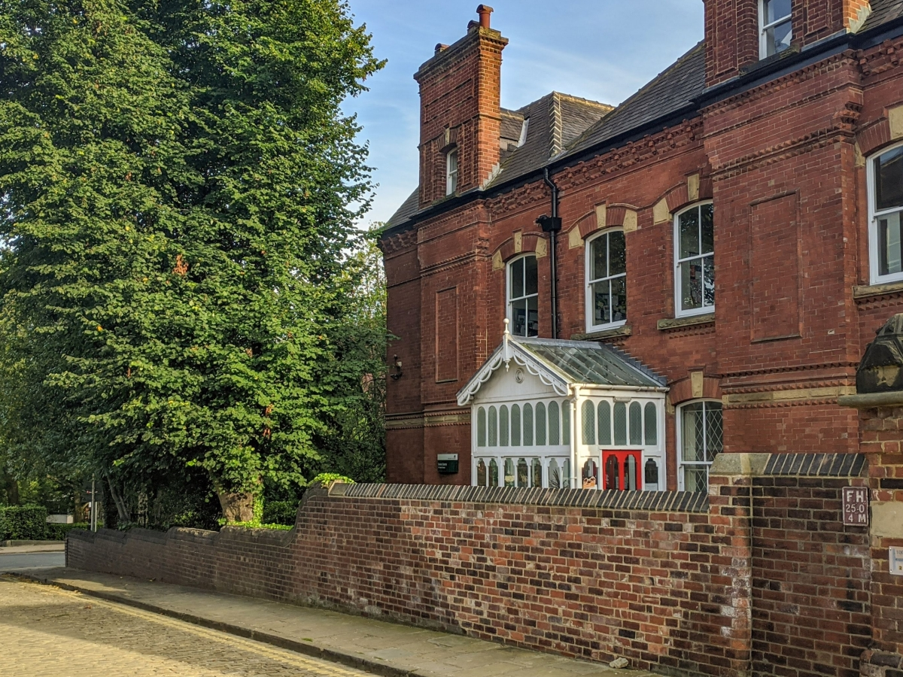
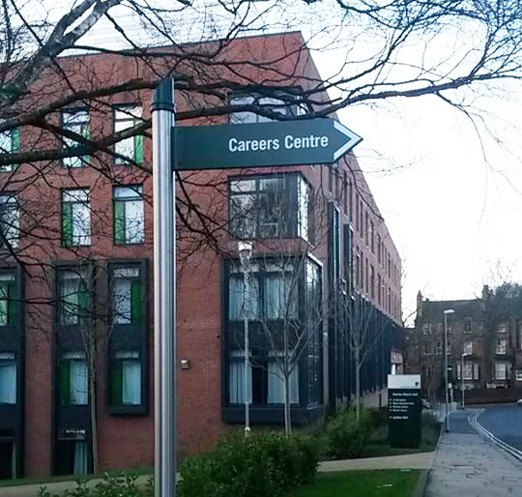
Employability and Opportunity Team / Careers Service
Career's Consultant Appointments
CV Checking, Interview Practice
Internships and other paid opportunities
Events / Talks / Networking Opportunities
Summer Schools
Study Abroad Year
Mentoring
Notes:
Chris – can you lead this one?

Slide 6
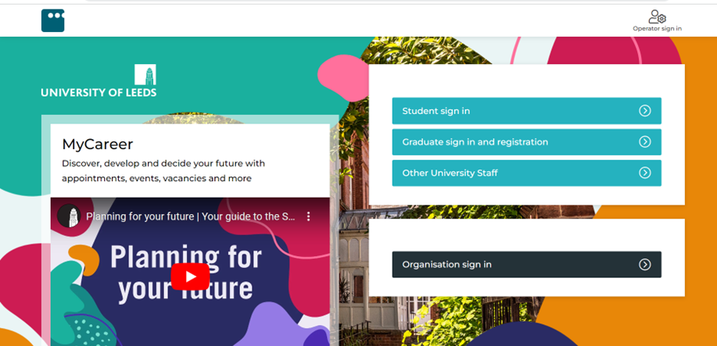
MyCareer
WWW.MYCAREER.LEEDS.AC.UK
Notes:
CH – Stress to remind them to register for MyCareer if not already done so.

Slide 7
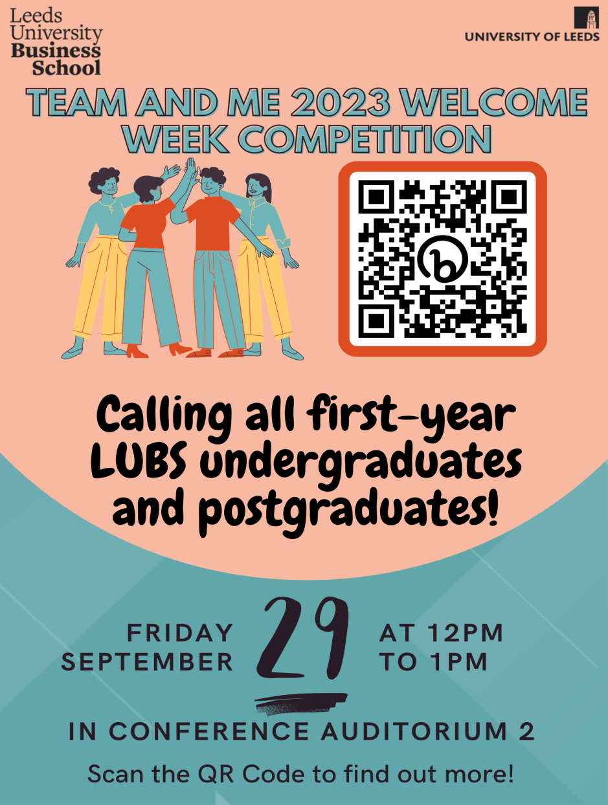
Launch - 29th September 2023
Submit individual request to be added to a team by 12noon Friday 6th October
Submit a Team Entry by 12 noon Friday 6th October
Competition submissions to be received by 12 noon Sunday 19th November
Judging - between 20th November and 30th November
Winner announced - After 1st December
Notes:
Tao will present this slide

Slide 8
What is Team & Me?
Team & Me is a team-based competition - first time running ☺.
It is open to all 1st Year Undergraduates and Postgraduates.
Team & Me aims to:
enhance students’ cultural awareness and cultural intelligence development.
identify future initiatives to improve student life at Leeds.
facilitate community and a sense of belonging among diverse student cohorts.
provide unique opportunities for participating teams to enhance their networks and employability opportunities.
Notes:
Tao will present this slide

Slide 9
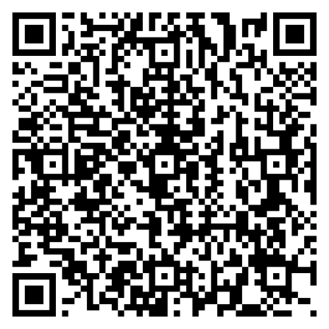
How to form your team?
If you’ve already formed a team, please email LubsOpportunity@leeds.ac.uk the following:
Team Name
Main contact for the team
Details of the other team members
Students can enter the competition in a voluntarily formed team of 4-6 persons.
Each team should strive to include members from a variety of national and geographical background.
If you would like us to help you create a team, scan the QR code on the right and fill in this form. We will match you with other students who also want to join the competition.
Please only use your Leeds University Student Email Address - Personal email addressed cannot be used.
Notes:
Tao will present this slide

Slide 10
The task
‘Demonstrate how your team plans to make a positive impact on student life at University of Leeds’. Demonstration needs to be either in the format of a video (no longer than 5 minutes) or narrated PowerPoints slides (no more than 10 slides).
Submission must be emailed to lubsopportunity@leeds.ac.uk by (12 noon Sunday Nov.19th).
Some teams may have already acted upon some or all of their ideas, equally, other teams may be just planning what can be done in the future. Marks will be given for how achievable/realistic the outcomes would be regardless of whether the plan has been acted upon or not.
'Student Life' covers their daily experiences at the University therefore, positive impacts can be related to their academic learning, personal and professional development/growth.
Notes:
Tao will present this slide

Slide 11
Judgement criteria
Aspects | Major Considerations | Marks
Team formation | Diversity and inclusivity of the team Team members’ role/contribution to the task Collaboration between team members | /25
Structure & Content | Clarity of material organisation Persuasive information and evidence Critical, analytical approach throughout Engaging content Originality of idea | / 25
Visual effects | Effective use of graphics Visibility/accessibility Creative design | / 25
Impacts | Potential benefits to student life at UoL Feasibility of implementation Wider impacts beyond the university | / 25
Notes:
Caroline – would lyou like to present this?

Slide 12
The prizes ☺
The exact split of the prizes will be determined once all the entries have been confirmed however they will include:
A team lunch with the Dean/Pro Dean of the Business School
An exclusive speed networking event with the management team at ASDA. This will take place at ASDA Headquarters and will include a tour of the ASDA Merchandising Suite.
Great Food at Leeds vouchers.
All participants will receive a signed certificate from the Dean/Pro-Dean.
Finalists will have their profiles shared on the LUBS Student Guide and other channels.
Notes:
Caroline – would you like to do this one as well?

Slide 13
Key dates
Entry
Friday Oct.6th
Submission
Sunday Nov.19th
Judging
Nov.20th to 30th
Result
Dec.1^{st*}
Notes:
Tao will present this one.

Slide 14
Support for you and your team
All participants can reach out for support by emailing LubsOpportunity@leeds.ac.uk or to Tao Jiang T.Jiang@leeds.ac.uk
Skills@Library: https://library.leeds.ac.uk/info/1401/academic_skills/110/group_work
Suggested books/articles about intercultural interaction/cultural intelligence*
Study/team discussion space: https://students.leeds.ac.uk/spacesforstudy; and more group/teamwork friendly spaces in Helix building https://digitaleducation.leeds.ac.uk/helix/
* Ang, Van Dyne, L., Koh, C., Ng, K. Y., Templer, K. J., Tay, C., & Chandrasekar, N. A. (2007). Cultural Intelligence: Its Measurement and Effects on Cultural Judgment and Decision Making, Cultural Adaptation and Task Performance. Management and Organization Review, 3(3), 335–371; Earley, & Ang, S. (2003). Cultural intelligence : individual interactions across cultures. Stanford University Press;
Notes:
Tao will present this one.

Slide 15
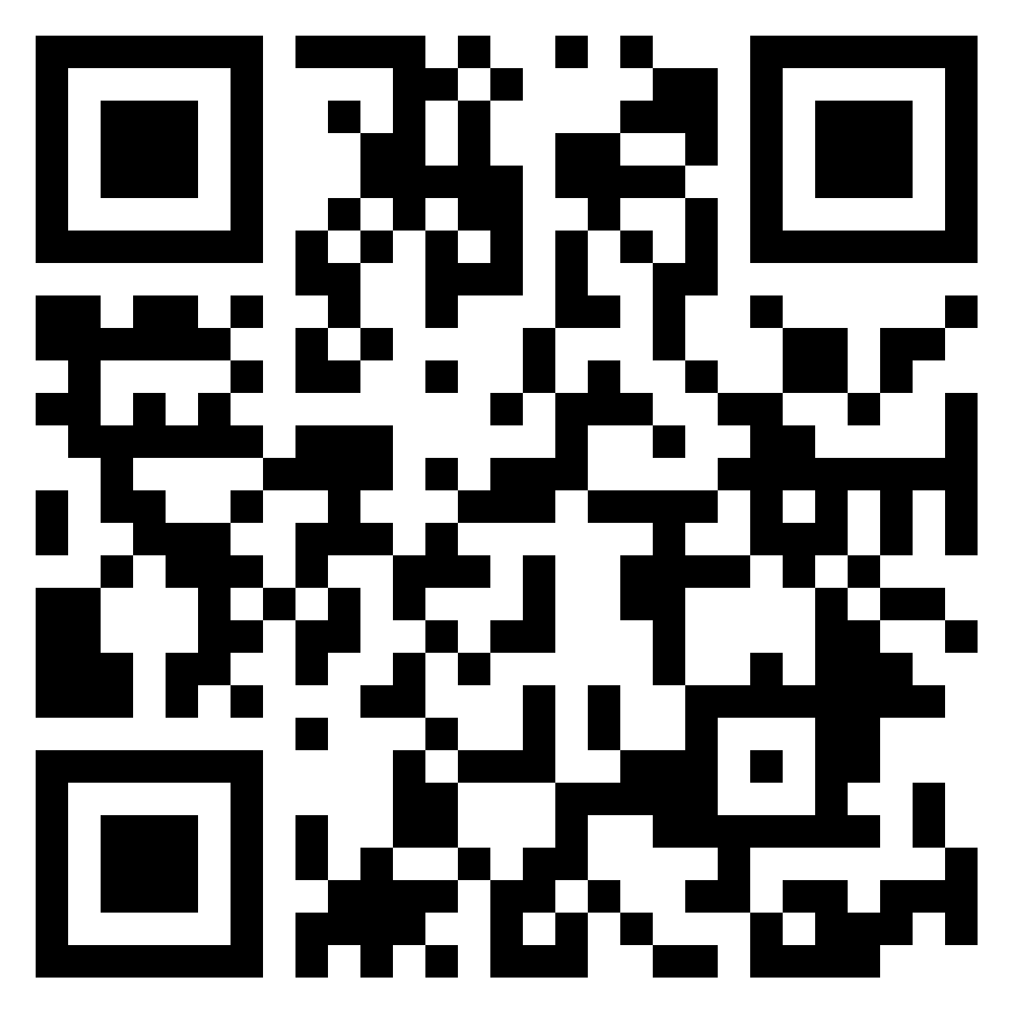
Thank you for listening ☺
Notes:
We all chip in to answer questions :-)

