Slide 1
Taught postgraduate Buddy Scheme

Slide 2
Contents
01
Creating your Vygo profile
02
Signing up to the Buddy Scheme
03
The matching process
04
Engaging with a Buddy

Slide 3
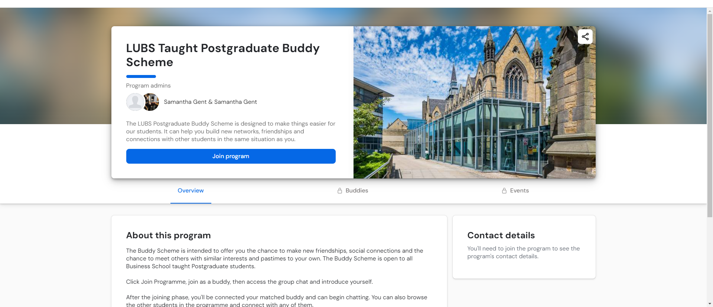
Step 1: Create your Vygo account
Go to: https://web.vygo.app/program/NnAukCbwPtsTjPlAGGSt to access the scheme

Slide 4
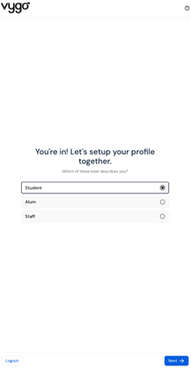
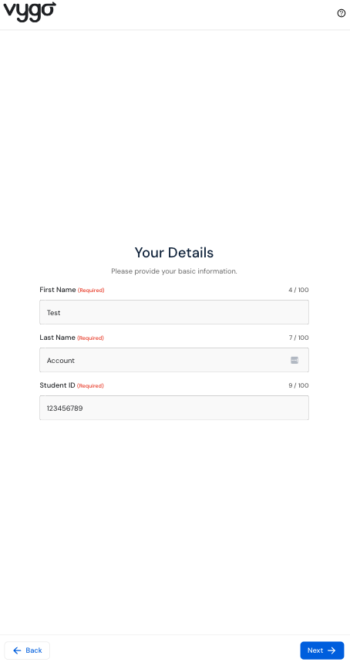
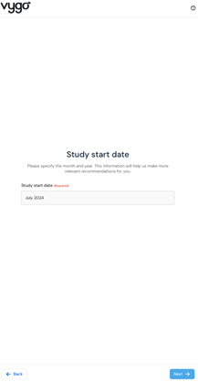
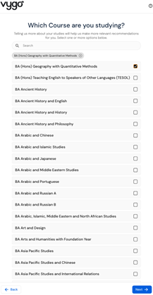
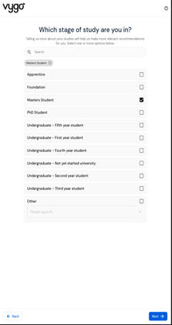
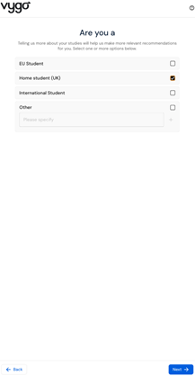
Step 1: Create your Vygo account
Select register/log in with organisation SSO, select University of Leeds and enter your login details, then please complete the steps below
Step 1
Step 2
Step 3
Step 4
Step 5
Step 6
Select ‘Student’ and click Next
Enter your name and student ID
Enter your study start date
Search for and select your course
Select your study stage
Select your student type

Slide 5
Step 2: Join the Leeds University Buddy Scheme Taught Postgraduate Buddy Scheme
You should see the LUBS Taught Postgraduate Buddy Scheme appear as a recommended programme on your homepage. If not, click the “Programs” tab.
Click the “View program” on the LUBS Taught Postgraduate Buddy Scheme.
This will take you into the Overview page. Read the information and click the blue “Join program” button.
You will be required to answer a few questions which will be used to pair you with a buddy who is most suited to your interests and needs.

Slide 6
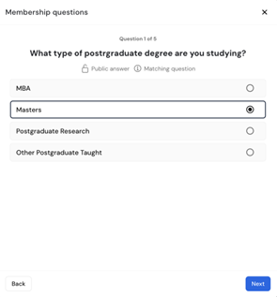
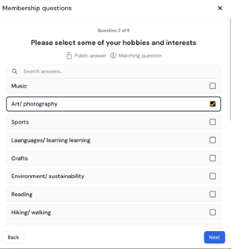
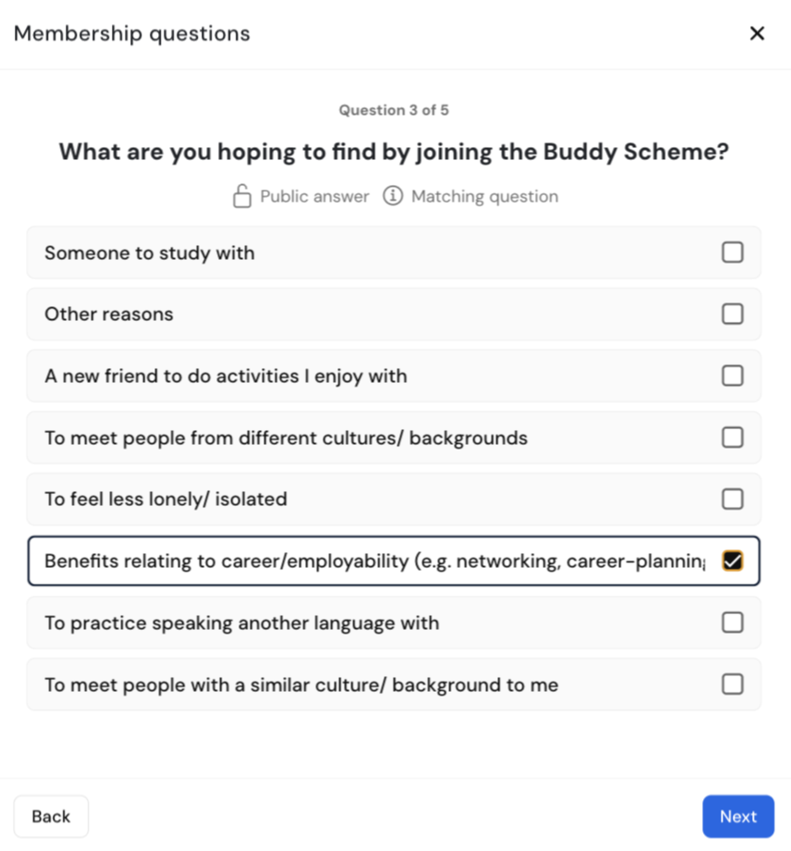
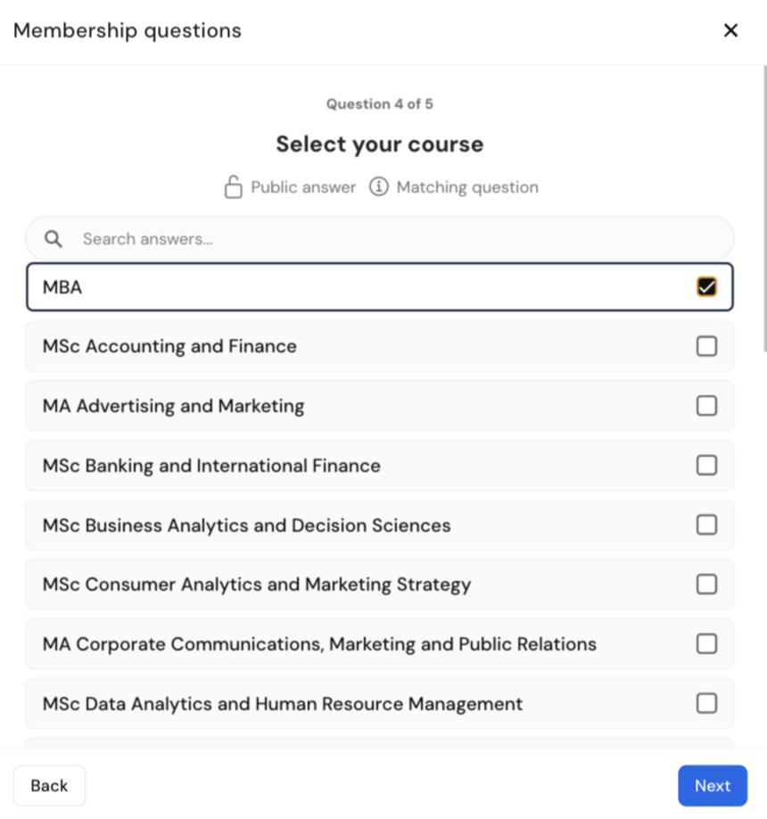
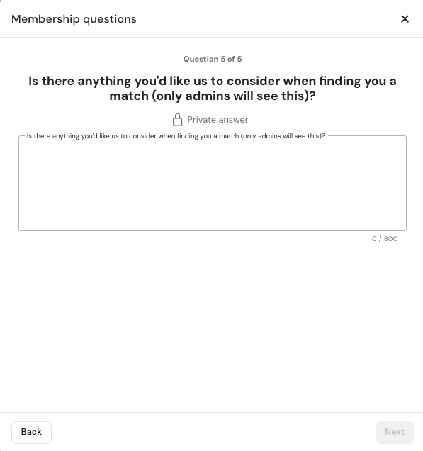
Step 3: Answer the join questions
Step 1
Step 2
Step 3
Step 4
Step 5
Select the type of postgraduate degree that you are studying.
Select some of your hobbies and interests.
Select a few reasons on what you hope to gain by joining the buddy scheme
Select your course that you are currently engaged in
Let us know if there is anything you would like us to consider in a match

Slide 7
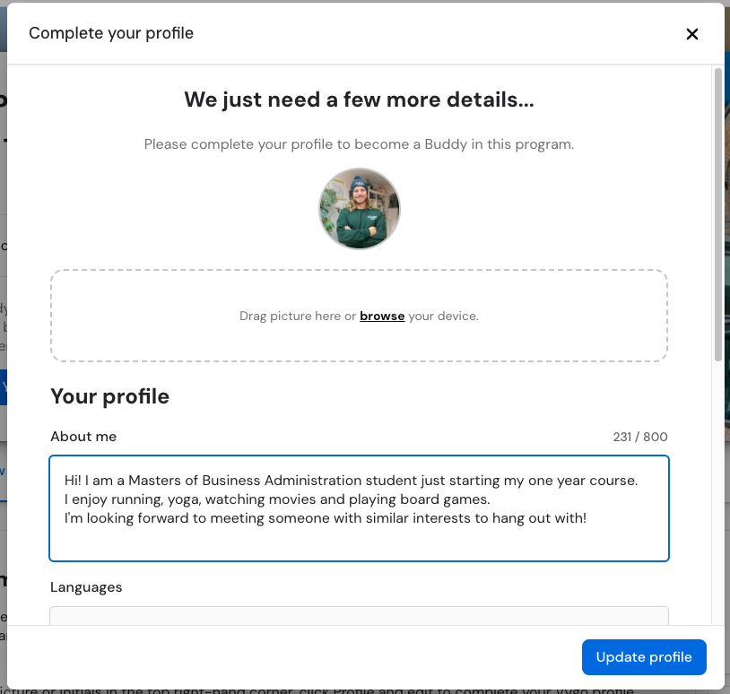
Step 4: Become a Buddy and complete your profile
After the join questions, there will be a set of guidelines, read these and click “Accept”.
You will then be prompted to become a Buddy - click “Become a Buddy” to accept.
Update the necessary parts of your profile.
Feel free to upload a selfie as your profile picture, or you can use any placeholder for your profile picture.
As a minimum put your study stage and course in you “about me” section, but feel free to let your personality shine!
Select any languages you speak
Add in at least one availability slot for now.
You can edit your profile information at any point by clicking on your picture in the top right.
Once complete, the blue button will say “You are a Buddy”, and you can wait to be matched with one of your peers

Slide 8
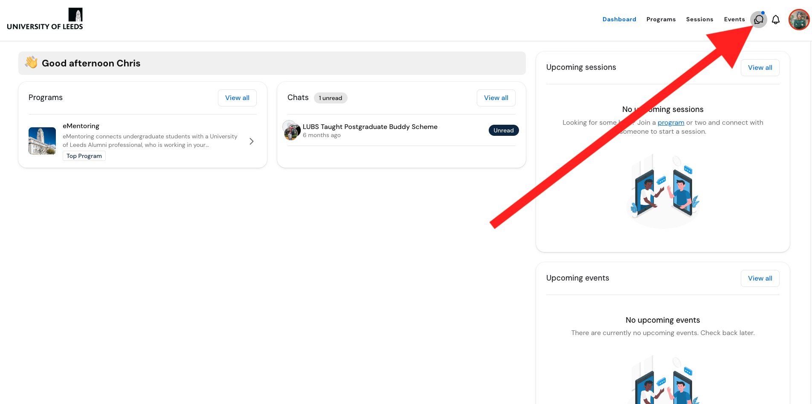
Step 5: You will now be matched with a buddy with similar interests.
The matching process takes 1 week, you will be emailed when you have been matched. You can view your connections and message in the chat area.
September 30th- October 7th
Oct 7th onwards
September 23rd-30th
P h a s e 2
Vygo algorithm matches students
P h a s e 3
Get to know your buddy via chats and by booking sessions
P h a s e 1
Everyone joins the Buddy Scheme
Students notified via email when a match has been found
Join in with the group chat
Make new connections!
Log in and visit your chat page

Slide 9
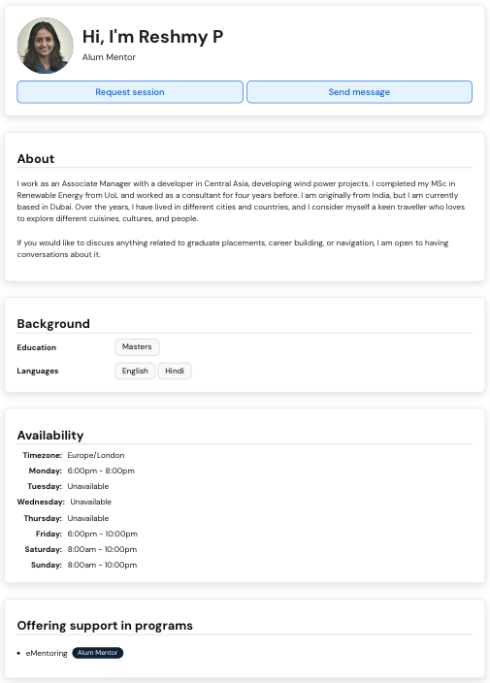
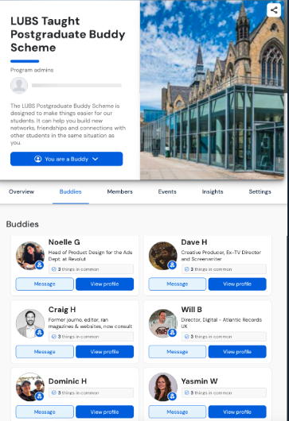
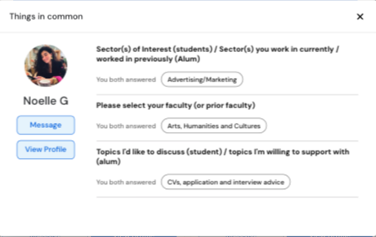
Step 6: If your match doesn’t work out or you are looking to make new connections you can reach out to a recommended Buddy at any time
To see what you have in common, select the option which says “Things in common” to view what you have in common with these buddies.
Click “View Profile” option to see the more information about them and “Send Message” to begin chatting.
From the recommended buddies tab, you will be able to view all buddies who have similar interests to you

Slide 10
Found your Match?
If you don’t want your profile to be visible to new contacts you can change your status at anytime by clicking on your profile picture.
Available: You are visible and contactable by other users
Busy: You are only visible and contactable by users you have already interacted with
Away: You are not visible or contactable by any other users
If you have any questions or problems during the application process, or during your use of the scheme, please contact LUBS Student Success Officer Samantha Gent

Slide 11
Useful Articles
More on the Buddy scheme
What is Vygo & How does it work?
Where can I access the Vygo Platform?
What web browser works best with Vygo?
How do I join a program?
How can i sign in with my SSO?

