Slide 1
Student Education Service
Welcome
Questions & Answers

Slide 2
Welcome from the Student Education Service
We will keep everyone’s microphones off to reduce noise issues.
This presentation will be recorded and available to rewatch on the LUBS Student Guide, but the Q&A at the end will not be.
Please do not raise your hand, we will not be using this function today.
You can ask questions at the end by using Vevox.

Slide 3
Information we will cover
Introduction to the Student Education Service (SES)
Student Information Service
LUBS Student Support
LUBS Student Guide
In-Sessional Language Support
Student Reps
LUBS Taught Postgraduate Buddy Scheme
Q&A via Vevox

Slide 4
Student Education Service – who are we?
The Student Education Service consists of various teams, all dedicated to assisting you throughout your student journey, from registration to graduation!
Academic Life
Exams and Assessment
Programme Support
Digital Learning
Health and Wellbeing
Opportunities

Slide 5
Timetables
Teaching sessions: Lectures, seminars, workshops & practicals
all start at 5 minutes past the hour and finish at 5 minutes to the hour.
This allows for 10 minutes to move around campus.
Students with one module finishing at 10am and another module starting at 10am don’t have a clash and usually we wouldn’t amend the timetable for such reasons.
Read more about timetables on the LUBS Student Guide:
“Requesting a timetable change”

Slide 6
Student Information Service
The Student Information Service (SIS) provides general support to students studying in all faculties.
You can contact them via telephone, email, or in-person at one of their five information points located across campus.
The University Support page of your LUBS Welcome Pack has details of how to find or contact the SIS.

Slide 7
General Queries
The answer to many questions can be found at:
https://students.leeds.ac.uk/

Slide 8
Business School Student Support Team
We can advise on
Support and options available for you, if your studies are affected by unexpected circumstances.
Signposting to other support and services.
Support available for disabilities whilst studying.
Taking temporary leave from studies.

Slide 9
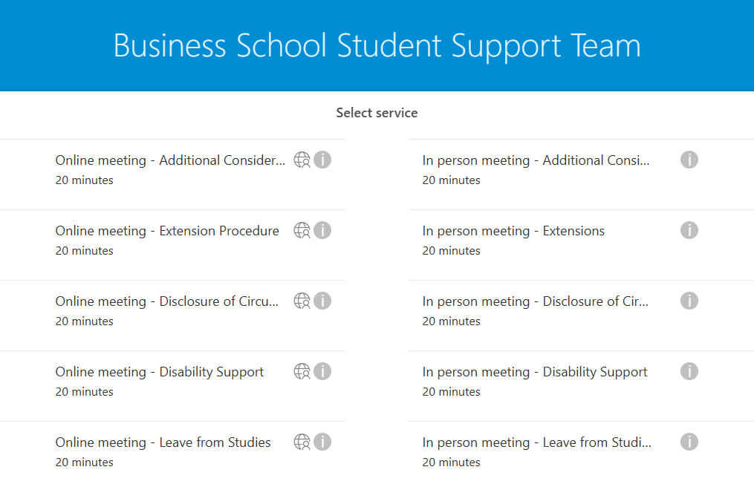
Student Support Officers
Learn about booking an appointment with one of our Student Support Officers on the LUBS Student Guide
​Our team offer a mixture of in-person and online appointments every day.

Slide 10
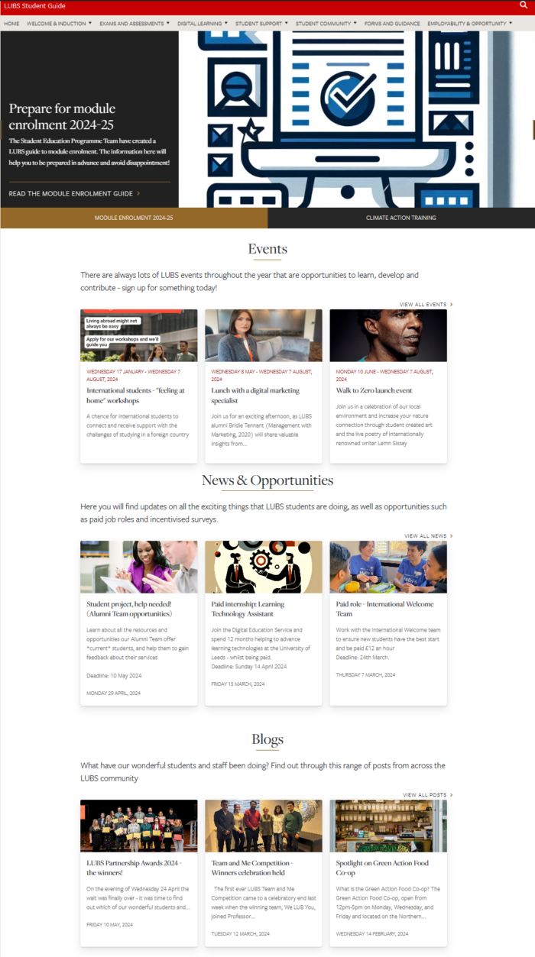
LUBS Student Guide
The Student Guide is a website specifically for LUBS students.
Bookmark and explore the Guide for everything you’ll need during your time at the Business School, including:
Academic resources
Co-curricular events
LUBS news & articles
Support
Student opportunities.

Slide 11
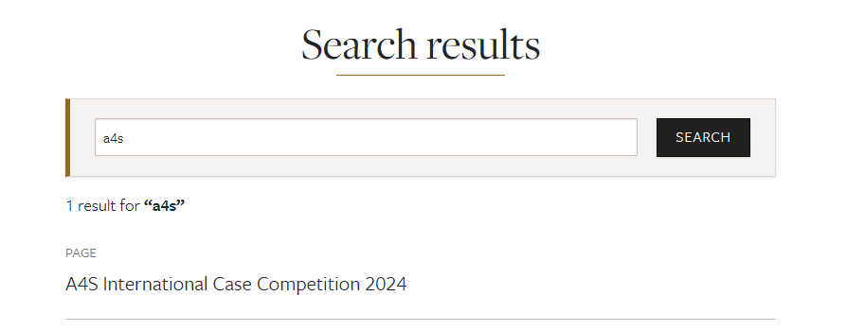
LUBS Student Guide: A4S Competition 2024
Work on a real-world decarbonisation project and compete for incredible prizes.
Open to teams of 3–5 students from any discipline, with a focus on business and accounting skills.
LUBS will shortlist the best entries internally before submitting the top 2 or 3 teams to the international competition.
Go to the Student Guide and search for A4S

Slide 12
LUBS Student Guide – Academic Integrity
Action: complete the Academic Integrity Test on Minerva.​
​
The link is on the Academic Integrity page in your LUBS Welcome Pack.
The test opens:
week commencing Monday 23 September 2024

Slide 13
LUBS Graduation Yearbook
All students have the chance to create an entry in the free LUBS yearbook platform.
Invitations will be sent out by the LUBS Communications Officer from September 2025.
Please ignore and delete any email claiming to offer a yearbook before that date, and not sent from a “leeds.ac.uk” account
Criminals target students each year with scam yearbooks – don’t be fooled!

Slide 14
In-sessional language Support
In-sessional Language Support offers free English language tuition to help improve your academic writing and literacy skills.
Your LUBS Welcome Pack has a video introduction to the course, as well as links to library resources available to all students. ​
Please sign up by 4th October

Slide 15
Student Representatives
Course Representative
Represent students on a particular course.
Seek student opinions to enact positive change.
Share feedback with staff and School Representatives.
Recruited by the Business School.
School Representative
Represent students in entire Business School.
Relays student opinions from Course Representatives.
Provide a link between staff, students, and Leeds University Union.
Recruited by the Leeds University Union.

Slide 16
LUBS Student Guide: A4S Competition 2024
Work on a real-world decarbonisation project and compete for incredible prizes.
Open to teams of 3–5 students from any discipline, with a focus on business and accounting skills.
LUBS will shortlist the best entries internally before submitting the top 2 or 3 teams to the international competition.
Go to the Student Guide and search for A4S

Slide 17
Become a Course Representative
Improve your employability
Receive accreditation and recognition for your commitment
Work in partnership with Business School staff and students
Network with other Course Representatives
Approx. 1 hour a week.
How to apply:
Visit the LUBS Student Guide Community section
The Deadline to apply is 23:59, Monday 7 October 2024

Slide 18
LUBS Postgraduate Buddy Programme
This scheme is open to all Postgraduate students and aims to match students together, either in pairs or small groups, to help students connect and build a sense of community.
You can find out more and apply through the
Student Guide Buddy Scheme page

Slide 19
Who to contact
Student Information Service Studentinfo@leeds.ac.uk
For any general questions about University life
LUBS Student Support LUBSStudentSupport@leeds.c.uk
Student wellbeing concerns, mit circs, temp leave
LUBS Assessment LUBSAssessment@leeds.ac.uk
For any assessment related questions or problems, such as issues with submitting your work
LUBS Attendance LUBSAttendance@leeds.ac.uk
Any attendance or absence related issues or questions, late arrivals, change of location
LUBS Programme Support / Quality LUBSQuality@leeds.ac.uk
Module enrolment / changes, programme changes, programme queries, academic integrity

Slide 20
Common Questions
Remember to check University webpages first for quick answers to questions
Accommodation
accom@leeds.ac.uk &
https://accommodation.leeds.ac.uk/
Fees and Funding
PGfees@leeds.ac.uk &
https://www.leeds.ac.uk/masters-fees/doc/fees-masters-fees
Registration
https://students.leeds.ac.uk/info/10102/registration/1056/how_to_register

Slide 21
Common Questions
Remember to check University webpages first for quick answers to questions
Module Change
https://students.leeds.ac.uk/info/10104/making_changes/652/change_of_module
How to use Minerva
https://students.business.leeds.ac.uk/digital-learning/new-students/
BRP
https://students.leeds.ac.uk/brpcollection
International Student Arrivals
https://www.leeds.ac.uk/info/130113/preparing_for_leeds/112/arriving

Slide 22
Common Questions
Remember to check University webpages first for quick answers to questions
IT Support
https://it.leeds.ac.uk/it
Library services
https://library.leeds.ac.uk/
Leeds University Union (LUU)
https://www.luu.org.uk/

Slide 23
Questions
https://vevox.app/#/m/170717903
Session ID: 170-717-903

