Slide 1


LUBS
Year in Industry
Work Placement
First Year Session
LUBS Employability and Opportunity Team
Notes:
Today’s session is designed as a first introduction to placements – to go over what a placement year is, why students choose to do one, and how you can start preparing early.
This is not a session where we expect you to have everything figured out. You’re only at the end of first year. This is about helping you understand what’s coming next get a head start over the summer with some potential early opportunities.
You’ll get much more detailed support in second year including talks in induction week, we will also have opportunities to speak with employers and students who’ve been on placement. Today is about laying the foundations and getting a head start over the summer.
While we’re running the session, please keep microphones off. If you have questions, use the chat where one of the team will be able to answer as we go or come back to them at the end.”

Slide 2
Contents
01
  Our Team
02
  Placement Year
03
  Previous Years
04
  Summer and Beyond
Supports
How we can help
Benefits
Eligibility and Criteria
Fees and Finance
Timelines
Previous Employers
Summer Tasks
Further Opportunities
Central Career Service Support
How to stay in Touch
Q & A

Slide 3
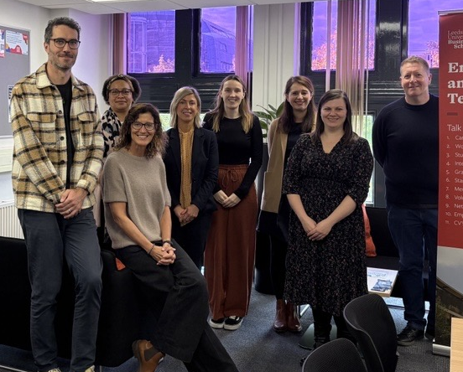
Who are we and what do we do?
LUBS Work Placement Team
Part of LUBS Employability and Opportunity Team
For general employability questions and advice
LUBSopportunity@leeds.ac.uk
For Work Placement queries
LUBSplacements@leeds.ac.uk
LUBS Careers and Opportunities Hub
Maurice Keywork GM.01
Appointments, Newsletters and more…
Notes:
We are from the LUBS Employability and Opportunity Team, which is part of the wider Careers Service but focused specifically on Business School students.
Emphasise that students do not need to figure things out alone.

Slide 4
What is a LUBS Year in Industry Work Placement?
LUBS Year in Industry allows you to work in a full-time, paid, graduate-level role for 9-12 months in the UK or overseas if we can authorise this with you, the employer and within the Uni as part of your degree programme.
How it fits into your degree programme?
Complete first and penultimate academic years as required by the University of Leeds
The Year in Industry is an extra academic year in between penultimate and final years on campus
(If you can progress in this way you complete a relevant module alongside work - plus if you pass final year too)
Your degree title changes to include (Industrial) E.g. BSc Management → BSc Management (Industrial)
Placement Year Module
Completed alongside work placement if eligible to progress
The module currently includes reflective assignments and employer engagement.
Notes:
A placement year, also called a Year in Industry, gives you the opportunity to work in a paid, full‑time, graduate‑level role for 9 to 12 months, and is available to any LUBS parented student.
These roles can be in the UK or overseas.
In terms of how it fits into your degree, you complete Years 1 and 2 as normal. You then go out on placement between Year 2 and your final year.
Currently you will all be on your standard 3 year degree programmes, successfully completing a placement year as part of your degree will mean this changes to the 4-year variant. For example, BSc Management becomes BSc Management (Industrial).
The placement year is not a year out, and is an assessed part of your degree.
During the placement year, you’re also enrolled on an associated placement module. This includes things like reflective assessments and employer engagement, and it means the University stays in touch with you and supports you throughout the year.

Slide 5
Eligibility & Requirements
Students can try for work placements that are:
9 to 12 months with a single employer
By exception 2 x 6 months | or | 1 x 6 and 1 x 3 months | In up to two different organisations
Paid at or above minimum wage
    If you wish to work for a charitable organisation, let us know job descriptions and pay details ASAP
In a full-time graduate-level role | with responsibility for managing people or projects
In the UK or overseas - if eligible to legally live and work in the relevant country for the duration
Academic
Must be eligible to progress following completion of 2026/27 academic year by year end
Academic grade requirement: No LUBS minimum | Employers may look for L1 & L2 60+ average
All placement offers need to be fully authorised by LUBS Work Placement Team
Notes:
This slide covers the basic eligibility and requirements, and again, this is just an overview.
Placements are normally completed with one employer and typically last between 9 and 12 months. Some students choose to complete 13–14‑month placements, which span both summers around the traditional academic year.
While there are alternative ways to meet the 9‑month minimum requirement, we don’t usually recommend these, as they can be more difficult to manage. Any variation would need prior approval.
Placements can be completed either in the UK or overseas, provided you are legally able to work in that country.
All placements must be paid at least the National Minimum Wage. In practice, many employers pay above this, and in some cases salaries can be quite competitive. Unpaid or low‑paid roles, such as some charitable positions, may be considered on a case‑by‑case basis, but this is rare and we would normally expect employers to meet minimum wage requirements.
The role itself must be graduate‑level, meaning it should involve real responsibility. Such as managing people or projects, so that you’re gaining meaningful experience that supports your development.
From an academic perspective, there’s no minimum grade requirement set by LUBS, although some employers may have their own criteria. Getting over 60 is always a good target.
You must also be academically eligible to progress onto placement.
If anything is unclear, or you find a role and are not sure if it meets the criteria then please get in touch with our team. We are here to support at all stages of the journey.

Slide 6
What a placement year might look like
Working arrangements
Role Styles
Fully in‑person: At employer’s worksite(s)
Hybrid: Mix of onsite and offsite working
Fully remote: Possible, but less common
Fixed role: One main job role throughout
Rotational programmes: Chances to move teams to experience different functions
What do work placement years involve?
Working on employers chosen workload - but also look for:
Real project work
Chances to collaborate with colleagues or other stakeholders
Chances to lead or manage others – or work towards this
On the job: Training/learning/mentoring/shadowing
Other benefits
Notes:
There is a lot of variety in a potential placement year and that’s a good thing.
Many placements are now hybrid, meaning you might spend some days in the office and some working from home.
Some roles are still fully in‑person, where you’re based at the employer’s workplace full‑time, which can be great for learning quickly and building relationships.
Fully remote roles do exist, but they’re less common, especially for placement students, because employers know how valuable it is to be around colleagues while you’re learning.
In terms of role styles, some placements are fixed roles. That means you stay in one main job area for the whole year, really building depth and confidence in that role.
Other placements are rotational programmes, where you move across different teams during the year, usually two or three rotations, so you get a broader view of how an organisation works and can figure out what you enjoy most.
No matter which type of placement you do, placement years are very much about real work. You’re not just observing, you’ll be contributing to real projects, shadowing colleagues, collaborating with different teams, and often taking responsibility for your own tasks or projects.
The key thing to remember is that there isn’t one ‘perfect’ placement. What matters most is finding something that helps you build skills, confidence, and experience that you can take back into your final year and beyond.

Slide 7
Benefits of a LUBS Year in Industry Work Placement
Build confidence
Develop practical workplace and life skills and gain valuable work experience
Consider what job and career path you want to pursue when you graduate
Opportunity to try a: sector/company/role
Build professional networks
Possibly gain a job offer before you graduate
Apply theory in practice
Provide high quality work experience for your CV
Students who do a placement are likely to achieve a higher final degree grade

Slide 8
Fees for Year in Industry Work Placements:
University Tuition Fees are reduced for the relevant placement year
We do not know figures for 27/28 academic placement year yet but…
The current University of Leeds Placement year fee structure is as follows:
        Fees will be substantially reduced for a study abroad or work placement year.
        The amount will depend on your year of entry.
        For UK (home) students paying the £9,790 tuition fee in 2026/27, the reduced fee is currently £1,465.
        Reduced tuition fees also apply to international students - see the Undergraduate Fees page
For international students, the reduced fee for a confirmed work placement year for 2026/27 is currently £4,425.
The reduced tuition fees reflect the: Continued student enrolment, support, and academic assessment during the work placement year if it can be fully authorised in line with Uni processes in the relevant year.
Fees may be subject to change.
To learn more view current Uni of Leeds > For Students > Webpages:
https://www.leeds.ac.uk/undergraduate-fees/doc/fees-undergraduate-fees
Notes:
Important caveat:
All funding, fees, and financial support schemes are subject to change each year.
Our team does not advise on funding, make decisions about funding, or influence tuition fee levels or eligibility.
For any funding‑related queries, students should always contact the Placement Funding Team at placementfunding@leeds.ac.uk.
Reduced tuition fee during placement year
Remain enrolled and are still supported academically.
Check the university links for the most up‑to‑date information.

Slide 9
Funding for Work Placement Year - What to consider:
Money considerations for:
All students – Costs: of living in different locations, what salary you might earn from work, cost savings*
International students – Student visa extension costs and timelines; funding from sponsors if appropriate too
Work Placements Abroad - Research all relevant costs, budgets and timelines upfront and ensure that you can get required documents to live and work legally in relevant country for the placement duration and that we can support too - ahead of making any commitments.
Funding**: We do not know funding processes or figures for 2027/28 yet
If eligible, currently students with confirmed placement offers for 2026/27 can apply for:
Student Loans to cover Tuition Fees and a reduced maintenance loans
Council Tax Exemptions
Student 18+ Oyster Card if living and working in London (re. TfL criteria)
Top up funding – students with a confirmed placement overseas in 2026/27 can currently try for something known as Turing Funding – but only if they meet with relevant eligibility criteria once their placement has been authorised in fully. A central team advises and reviews applications for this type of funding if available and this is reviewed yearly.
Funding may be subject to change. To learn more view Uni of Leeds > For Students > Webpages
https://students.leeds.ac.uk/fees-funding > Funding and Grants > Work Placements
https://students.leeds.ac.uk/funding-grants-work-placements/doc/fees-money-work-placements

Slide 10
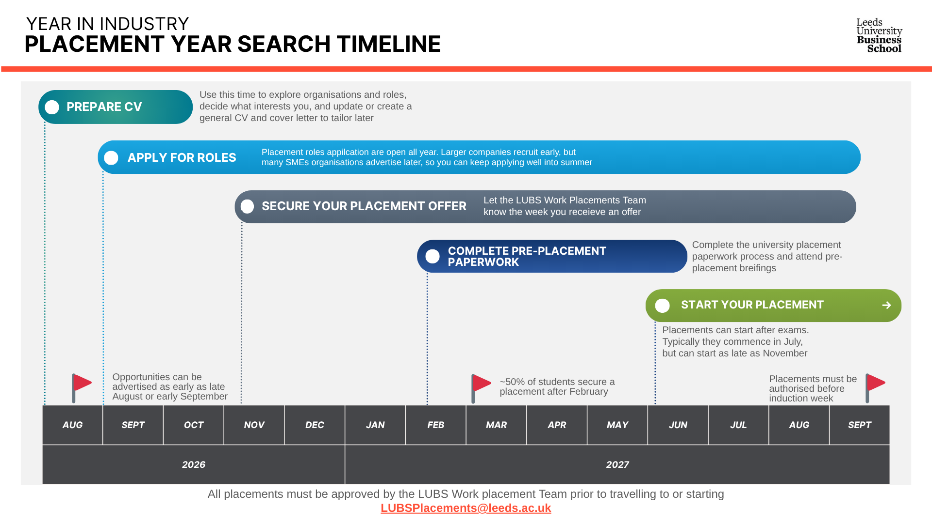
What a placement year looks like – Typical timeline
Notes:
Most applications open in autumn of second year.
Encourage starting early with CVs and LinkedIn.
Internal process once placement is secured (approval, forms, assessment) are all supported by LUBS.

Slide 11
























A few examples placement providers:
View a list of some of the previous placement providers for LUBS students on this spreadsheet.
Source: LUBS Student Guide | Year in Industry pages
Notes:
A snapshot of the range of organisations LUBS students have worked with.
You’ll see big names here, but it’s really important to say that placements aren’t just with large, well‑known companies.
Many students have excellent experiences in SMEs.
The spreadsheet linked shows a broader list, organised by degree, which can be really useful for inspiration - especially to see what students on your course have done before.

Slide 12

Support towards the Year in Industry
Module enrolment: LUBS2020 From Study to Work
    Semester 1, 10 credits
    For students interested in a placement year
    Builds key job‑hunting skills: Applications, CVs, interviews
    Includes employer‑led workshops
Nurturing Talent Mentoring Scheme (NTMS)
      Applications open for 2026/27 opens in May 2026

Slide 13

Support towards the Year in Industry - LUBS Placement Hunt Club 2026-27
Weekly help (term-time) penultimate academic year
The first week we’ll look at:
YOUR Placement Hunting Strategy and how to get started
What’s on offer placements and internships-wise
How, why, where and when to look for placements and internships
Costs, funding and fees
Following Wednesdays we’ll offer support with employer recruitment processes such as:
Getting started with and improving placements and internships job applications
Interviews types and techniques
Psychometric testing
Assessment centre techniques
Resilience – keeping going and ‘bouncing back’
Extra top tips from LUBS Work Placements Team, students and employers as part of the club too…
Notes:
I’ll be running the placements hunt club every weds during term time
It is designed to offer extra help with your placement hunt
You can drop in or out as the need arises during your placement hunt
We go at the groups pace
The club will help you to identify opportunities and expand your shortlist now or ahead which helps if you have received rejections
You can also expand you network and knowledge of placements - as placement students and employers will hopefully input too
Most of all I hope to help you increase your confidence and develop key skills that will help you to secure a placement opportunity
The club has a good 70-80% success rate amongst those students that regularly attend each week since it was set up over a decade ago!

Slide 14
LUBS Work Placements and Internships Hunt Club
Weekly Sessions focusing on your jobs hunt and employer hiring and recruitment processes
“The club was instrumental in:
Equipping me with the right tools to pursue and secure my year in industry.
Plus giving me invaluable advice and the confidence to back my own abilities.
I would advise any student looking to complete a year in industry to:
Become a part of the club and
Make the most of such a unique opportunity“
William - LUBS UG Student

Slide 15
What will help - Summer
Build a starter or update: CV and a basic cover letter template
Engage in work experiences - part‑time, full-time, volunteering, clubs or societies via Uni or beyond
Review and improve LinkedIn profile
  Review my LinkedIn tool
LinkedIn Learning – Upskill in an area
  New Professional certifications available through the LinkedIn Learning Career Hub
Research: Sectors, companies and roles of interest to you
  Times Top 100 or The UK 300
Sign up to alerts on job boards via:
  MyCareer
  Recommended Third Party websites
  Bright Network
  Trackr – Finance and Technology
Notes:
Create a starter CV and LinkedIn profile early.
Use LinkedIn Learning for skill development.
New professional certifications from companies like Microsoft, Adobe, Atlassian, CIPD, Grammarly, and many more
Recommend part‑time work, volunteering, societies - anything that builds experience.
Encourage exploring different industries through summer research.

Slide 16






Central Career Service supports
Careers
Service Blog
Employability tips, student stories and more from University of Leeds
  Virtual Internships
      Virtual experience programs designed by leading companies such as PWC, Red Bull, HPE, EY and more...

Slide 17
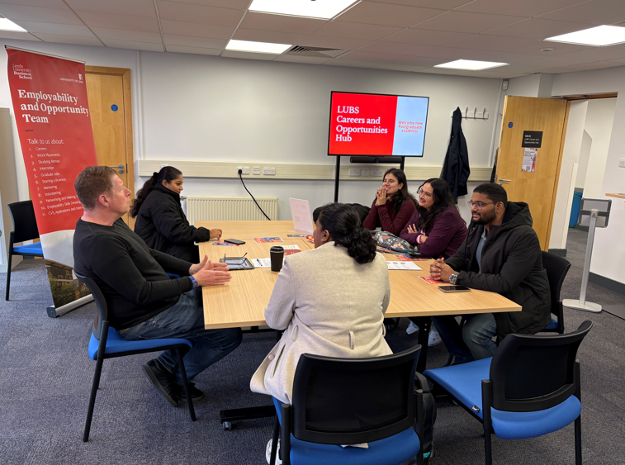
How our team can support
LUBS Careers and Opportunities Hub
Maurice Keyworth GM.01
  Drop into the hub 12-2pm during term time
1:1 Appointments
  Information and Opportunities
  Work Placements
  Application Support
  Mock Interview
  Mock Assessment Centres
  Career Path

Slide 18


Keep updated from our team
LUBSplacements@leeds.ac.uk
LUBSopportunity@leeds.ac.uk
More information on Year in Industry Placement Year is available on the LUBS Student Guide – Year in Industry Pages

Slide 19
Upcoming session
Level 1: Global Opportunities: Study Abroad, Work Experience and Short-Term Opportunities Talks
Have you ever dreamed of studying, living, or working abroad as part of your degree? Or do you want to know more about work experience opportunities available to you, both in the UK and overseas? At Leeds, you can do that with our exciting placement year options!
Session Option One:
Date: Thursday, 30/04/2026
Time: 16:00-17:00
Room: Conference Auditorium 2 (GM.01)
https://mycareer.leeds.ac.uk/leap/event.html?id=15640&service=Careers+Service
Session Option Two (Repeat)
Date: Wednesday, 6/5/2026
Time: 13:00 -14:00
Room: Conference Auditorium 1 (GM.03)

Slide 20


Slide 21


Q&A
Notes:
We know placements can feel overwhelming at this stage, so please ask any questions - there’s no such thing as a silly one.
If something comes to you later, you can always get in touch with the team, book an appointment or drop into the LUBS Careers and Opportunities Hub.

