Slide 1

Welcome – Student Experience and Opportunities
Marianne Savory
Director of Student Experience and Opportunities
Faculty of Business
September 2026

Slide 2
Introductions
Professor Julia Bennell
Pro-Vice-Chancellor: Faculty of Business
Marianne Savory
Director of Student Experience and Opportunity
Joined by:
Leeds University Union
Faculty Alumni Team
Faculty Student Education & Support Team
Faculty Students

Slide 3
Professor Julia Bennell
Pro-Vice-Chancellor: Faculty of Business
Notes:
Julia

Slide 4

Today
Welcome to the LUBS Community
Spaces to Learn & Develop Skills
LUBS Career and Opportunities Hub
Leeds University Union (LUU) and Student Societies
LUBS Alumni Network
Student Education & Experience Team
The Staff & Student Partnership
Student Representatives – Top Advice and Q&A

Slide 5
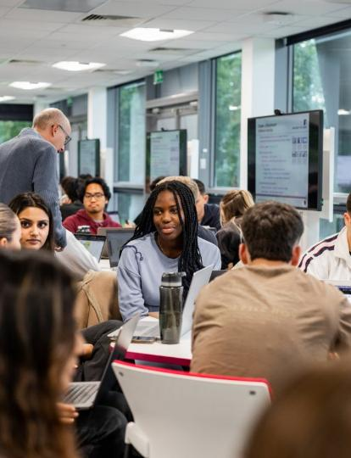
Leeds University Business School (LUBS)
Congratulations on becoming part of the LUBS community
You belong here – welcome!
Connect with others – build your network
Get involved and make the most of the opportunities available to you – find out how today

Slide 6
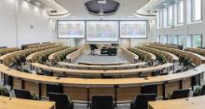
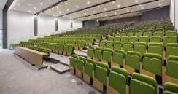
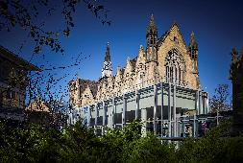

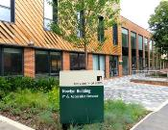
Spaces to Learn
Maurice Keyworth Building
Esther Simpson Building
Charles Thakarah Building
Clarendon Building
Newlyn Building
but we are much more than just buildings...

Slide 7
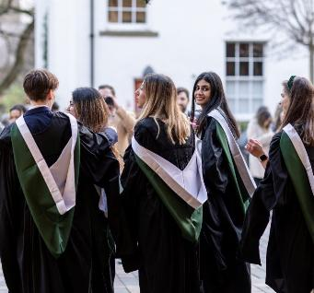
People, Skills and Your Future
You will develop a range of skills to be successful in your programme and beyond
Skill development is built into your modules - see these in your programme skills maps
Your personal and professional development will be supported at LUBS. Start to consider:
  What are your strengths?
  Where might you need to develop?

Slide 8
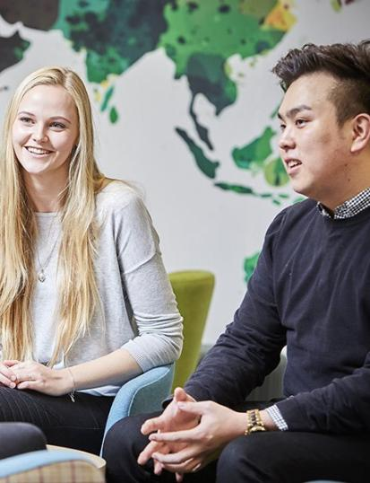
Inside and Outside of the Classroom
Business School Ambassadors
Competitions – lead a winning team
Student Programme Representatives
Sustainability Champion
International Opportunities – Study Abroad
Year in Industry
Guest lectures and employer workshops
LinkedIn Learning and MOS Qualification
Virtual Internships with GIP and FORAGE
Start your own business SPARK

Slide 9



LUBS Careers and Opportunities Hub
Dedicated Careers and Opportunities Hub in the Business School – Maurice Keyworth GM.01
Open for drop in every day 12pm – 2pm
Extended for Welcome 10am – 2pm Mon - Wed
Help with:
  Placements, Internships & Work Experience
  Study Abroad & Summer Schools
  Graduate Roles
  Applications, CV’s, Interviews

Slide 10
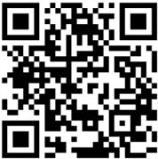
MyCareer
🔍 Discover jobs, internships and graduate opportunities
📅 Book appointments with Careers Consultants
📝 Get CV, application and LinkedIn feedback
🎯 Prepare for interviews and assessment centres
🤝 Connect with employers, alumni and recruiters
🚀 Access exclusive events, workshops and networking opportunities

Slide 11
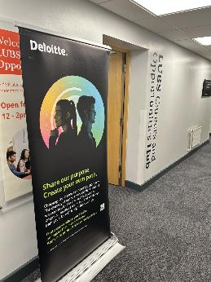
Hub Guest Series
Meet employers and industry professionals — right here in the Hub.
Joining us in 2026/27
Deloitte
Bloomberg
Accenture
Institute of Internal Communications
Fusion Unlimited
And many more…

Slide 12


Example - HUB Events Schedule – shared fortnightly

Slide 13

Notes:
Over to you Alan

Slide 14

Notes:
Hi everyone, my name is ____ and I’m from your Students’ Union. We’re here to help you love your time at Leeds.
POTENTIAL ICEBREAKER HERE
We know this is a busy week with a lot of information so we’ll keep it short and sweet.
Leeds University Union is located at the heart of campus - the big building with the plaza outside - show of hands if you’ve already been?
We are a student-led organisation, independent from the University, but we work very closely in partnership with them. Today I’m going to briefly explain who we are, what we do, and how we can help you make the most of your first year at Leeds.
Our next slide is a quick video giving a snapshot of life at LUU...

Slide 15


BE REPRESENTED & MAKE A CHANGE
STUDENT EXEC
SCHOOL REPS, COURSE REPS, PGR REPS,
FACULTY OFFICERS, INTERNATIONAL REPS
MAKE IT BETTER
ELECTIONS
luu.ac.uk
Notes:
LUU is run by students, for students - and that means we have your back when it comes to making a change.
LUU develops policy based on what students want, and we work with the University to try and implement it - for example, we worked with the libraries team to be able to offer 24 hour opening in the Laidlaw library after students fed back that they needed somewhere to study overnight.
Other ways in which your voice is raised include sustainability and liberation groups, and community volunteering projects.
Every student at Leeds has an Academic Representative at either your Course, School or Faculty level - they take your feedback to senior staff to make changes, or let them know what’s going well!
[INTRODUCE SCHOOL REP IF AVAILABLE]

Slide 16


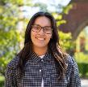
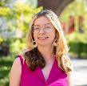
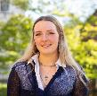

Student Executives
As the elected Trustee Team sitting on the Trustee Board at the Union, they represent student interests within the Union, the university, the city of Leeds and the country.
MEET THE EXEC TEAM
a
y
a
A
s
h
o
k
A
n
e
k
a
J
e
n
n
i
n
i
n
n
a
T
i
g
s
A
b
n
d
Welfare & Liberation
Student Executive
Student Opportunities & Development Student
Executive
GET TO
A.Anand@luu.ac.uk
T.Jennings@luu.ac.uk
KNOW US:
c
y
H
t
e
r
h
o
e
m
O
L
u
a
r
t
W
a
u
s
e
u
b
k
e
k
i
e
-
R
D
e
v
e
l
e
y
d
S
Union Affairs & Community Student
Executive
Academic Experience
Student Executive
International Experience Student
Executive
luu.ac.uk
L.Hart2@luu.ac.uk
S.Waterhouse-Reed@luu.ac.uk
D.Okeke@luu.ac.uk
Notes:
Your exec officers are elected every year to lead the Students’ Union which means our most senior leaders in the organisation are quite literally students!
**Explain the election process briefly**
Check this with Exec:
Abinaya Asok Anand
Welfare and Liberation Student Executive Officer
Abinaya has a focus on on all things welfare and liberation.
Tineka Jennings
Student Opportunities and Development Student Executive
Tineka is here to help you thrive at Uni, through getting the right funding for clubs and societies, tackling the cost of sport or making sure our co-curricular activities are the best in the country
Lucy Hart
Union Affairs and Community Student Executive
Lucy chairs the board of trustees, makes sure the Union works for you and that the charity’s money is spent in the right areas.
Sylvie Waterhouse- Reed
Academic Experience Student Executive
Sylvie changes things up for the better so that the Uni is always providing the best academic experience.
Dubem Okeke
International Experience Student Executive
Dubem makes sure our diverse community is properly represented, and leads on the creation of opportunities to share culture and experiences.
You can follow your officers by scanning the QR code straight Instagram

Slide 17


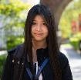


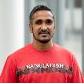
Our Faculty Engagement Leaders advocate for students at Faculty level and other academic committees, influencing decisions on assessment, feedback, resources, timetabling, and exams.
MEET THE FACULTY ENGAGEMENT LEADERS
a
m
m
e
d
A
l
m
m
a
C
h
a
l
o
n
o
h
a
h
E
m
e
r
M
r
i
Medicine & Health Engagement Leader
Engineering & Physical Sciences Engagement
Leader
GET TO
M.Almahri@luu.ac.uk
E.Chaloner@luu.ac.uk
KNOW US:
t
T
o
n
g
y
u
Z
h
a
y
a
n
i
G
a
w
a
b
a
r
a
k
H
o
s
s
C
a
o
u
a
r
n
d
M
o
a
i
n
N
e
Arts, Humanities & Culture Engagement Leader
Environment and Social Sciences Engagement Leader
Business School Engagement Leader
luu.ac.uk
Notes:
Introduce the relevant Faculty Engagement Leader and their role
Faculty Engagement Leaders gather information from all the School Reps in a Faculty to provide insights to senior decision-making bodies in the University so that your specific experience is considered for any University-wide policies.
They also work with other LUU Student Leaders to review and suggest policy that is beneficial for all students.

Slide 18




As the elected Liberation Engagement Leader team, they work to organise, enable, create, build and bridge communities based around liberation identities.
MEET THE LIBERATION & IDENTITY ENGAGEMENT LEADERS
ASH MALLEN
KELSEY WITTNER
LGBTQ+ Engagement Leader
Gender Engagement Leader
GET TO
A.Mallen@luu.ac.uk
K.Wittner@luu.ac.uk
KNOW US:
KAYLA JANEETA RAHARDJO
LULA HOFFMANN
Race & Ethnicity
Engagement Leader
Disabled &
Neurodivergent
Engagement Leader
luu.ac.uk
J.Rahardjo@luu.ac.uk
L.Hoffmann@luu.ac.uk
Notes:
Introduce the Liberation and Identity Engagement Leaders:
Need a sentence on each

Slide 19



FEEL GOOD & FIND SUPPORT
ADVICE AND WELLBEING WELLBEING CAMPAIGNS ESSENTIALS
LUU. HERE FOR YOU!
luu.ac.uk
Notes:
Obviously we hope your time at Leeds passes without incident but just in case things go wrong, our independent Help & Support service offers free and confidential advice in areas like academic misconduct, housing and finance issues and loads more. You can browse their self-help pages, or book a 1:1 appointment on our website. Reception desk at LUU.
The Help & Support team also curates a year-round programme of mindfulness, which includes events and workshops, ranging from pet therapy and mindful colouring, to sexual health screenings and stalls with national mental health organisations.
At Essentials, you’ll find emergency food assistance, non-perishables, and breakfast products, as well as sanitary products to pick up for free. Essentials also offers signposting to support services, including wellbeing, and financial literacy.

Slide 20


FIND YOUR PEOPLE & FUEL YOUR PASSIONS
CLUBS & SOCIETIES GIVE IT A GO EVENTS CROSSROADS JOBLINK
luu.ac.uk
Notes:
We’re home to more than 300 clubs and societies - including course societies, sports clubs, culture and faith groups and every hobby you can imagine.
*** if you are feeling brave potentially challenge the audience to name a society and then look it up on Engage to see if we have it or something similar. If it's not there then we can work with you to develop a new society****
My advice for this week is to seek out one or two societies that you like the sound of and drop in to say hi to them – you can make friends in University societies and it’s a great way to see the campus and wider city.
[IF PRESENT INTRODUCE ACADEMIC SOC TO TALK]
Mention welcome fairs – and option of 'Give it a go' activities where you can try a society without obligation to see if you enjoy.
Crossroads - Crossroads is our very own gaming hub. With countless board games, consoles, and video games, Crossroads is the perfect place to hang out and relax between studying!
PGR Lounge - (if your audience includes PGRs): Are you a post-graduate researcher? If so, the PGR Lounge is for you! The PGR Lounge is a chill space built for you to study, relax and connect with others, without any typical university distractions.
Joblink - Joblink is a student job shop, designed to link students up with local employers who provide a rewarding work experience. Run by students with student needs at the heart of their mission, Joblink has a vast catalogue of flexible and fulfilling work that suits student schedules and interests – including part-time roles, short-term employment, and internships. Besides, Joblink offers training and online learning to prepare students to be their best.
Find out more at LUU.org.uk

Slide 21









STUDY & SOCIALISE
CAFES & BARS SHOPS
STUDENT SPACES FRUITY
GIGS
LUU REWARDS:
Apple
Google
luu.ac.uk
Notes:
LUU has meeting rooms, dance studios, a Theatre, a nightclub, shops, study spaces, food outlets, kitchens and showers for all your needs. You can pick up your groceries or household essentials in our Co-op, grab a University of Leeds hoodie or other branded clothing in Gear, and stock up on pens and notebooks in Union Shop.
As for food, you’ll never be hungry in LUU - Old Bar is our traditional old school pub, you can enjoy a pizza and a cocktail in the Terrace bar, or grab a sandwich and coffee in Common Ground or one of our food outlets including: Philapita, Waki Maki, Pearls Bubble Tea, Cooplands and Tikka Nation (add in Maxis and jacket Potatoe when available). There’s also microwaves to heat up your own food and plenty of spaces to take a break.
LUU Rewards allows you to earn points for spending money in our LUU outlets. Yes, with our new LUU Eats app, you literally will be rewarded for having a burger in Old Bar or enjoying a coffee in Common Ground. Scan the QR to access.
We also have multiple events venues where you’ll be able to enjoy gigs, comedy shows, theatre performances and club nights right here on campus. Fruity Friday anyone?!?!

Slide 22



WELCOME WEEK EVENTS
THE FRESHERS ARRIVAL PARTY MUSIC BINGO NIGHT
FRUITY’S 25TH BIRTHDAY PARTY TRIP TO NEWCASTLE AND DURHAM OLD BAR OPEN MIC NIGHT
CLUBS AND SOCIETIES FAIR TERRACE SPEED QUIZ
luu.ac.uk
Notes:
We have a Jam-packed schedule of events. Visit our website or follow the QR to access Engage where you can find out about all our upcoming events and activities.
Mention some upcoming events

Slide 23

Notes:
Highlight events

Slide 24


Slide 25
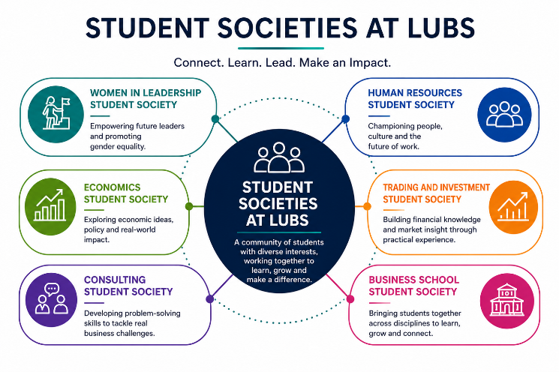
Notes:
Alan

Slide 26

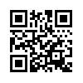
LUBS Alumni Team
What can you do now whilst you’re at Leeds?
Make use of our career resources
Professional development webinars
Next webinar 5 November – Harnessing the power of Influence
Entrepreneurial support – SPARK
Connect with alumni
In the classroom – with alumni speakers
On LinkedIn
Via our alumni groups across the globe
Mentoring schemes
Leaders in Residence
For coursework/dissertation research
For career advice
Come to our events and network
Alumni events in the UK and around the world
LUBS speaker events eg Lunch with alumni
Connect with us
Instagram: leedsunibschool
LinkedIn: Leeds University Business School Alumni
Wechat ID: LUBSAlumni
Find out more business.leeds.ac.uk/alumni
Or email alumni@lubs.leeds.ac.uk
Alumni video

Slide 27
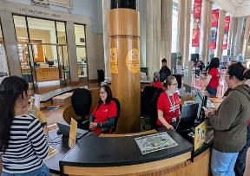
Student Information Service
The Student Information Service (SIS) provides general support to students studying in all faculties.
You can contact them via:
Telephone (0800 915 0402)
Email (studentinfo@leeds.ac.uk)
Campus information points
  Parkinson Building
  Chemical and Process Engineering
  Maurice Keyworth Building
  Worsley Building
  Marjorie and Arnold Ziff Building

Slide 28

LUBS Student Education & Experience – who are we?
Student Education & Experience consists of various teams, all dedicated to assisting you throughout your student journey - from registration to graduation!
  Academic Life
  Exams and Assessment
  Programme Support
  Digital Learning
  Health and Wellbeing
  Opportunities

Slide 29
Student Representatives
Course Representative
Represent students on a particular course.
Seek student opinions to enact positive change.
Share feedback with staff and School Representatives.
Recruited by the Business School.
School Representative
Represent students in entire Business School.
Relays student opinions from Course Representatives.
Provide a link between staff, students, and Leeds University Union.
Recruited by the Leeds University Union.

Slide 30
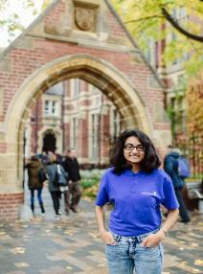
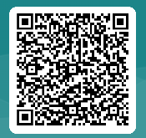
Become a Course Representative
Improve your employability
Receive accreditation and recognition for your commitment
Work in partnership with Business School staff and students
Network with other Course Representatives
Approx. 1 hour a week.
Applications are open!
Learn more →
The Deadline to apply is 23:59, Monday 5 October 2026

Slide 31
Student Voice at LUBS
SCHOOL REPS
Bring student priorities into Faculty-level decisions.
PROGRAMME REPS
STUDENT SOCIETIES
Share cohort feedback and champion improvements.
Build community, belonging and diverse perspectives.
STUDENT VOICE
Listen • Collaborate • Act • Improve
LEEDS UNIVERSITY UNION
STUDENTS + STAFF
Supports representation, advocacy and wider change.
Co-create solutions and turn ideas into action.
Every student has a voice. Together, we shape the student experience.

Slide 32




What do our students say?
Attend class! Get to know your classmates
Ask for help when you need it – Lecturers and Personal Tutors are always happy to help – make the most of their office hours
Avoid cafés on the hour, when lectures start and finish
Join a LUBS Society
Look at the details of your modules and the assessment formats
If you are unsure about academic writing, see skills@library to see what is expected
Plan your time over Semester 1 and 2 so you don't get stressed
Check your university emails

Slide 33

Questions & Answers
Your opportunity to ask anything in the chat box.
If we are not able to respond now, we will be sure to follow up and email you a response.

