Slide 1

2026/27
LUBS Taught Postgraduate Buddy Scheme
01
02
03
04
Creating your Vygo account
Joining the Buddy Scheme
Timelines for the matching process
Engaging with a buddy
Notes:
Cover. Seven steps take a buddy from a new account to chatting with their match.

Slide 2

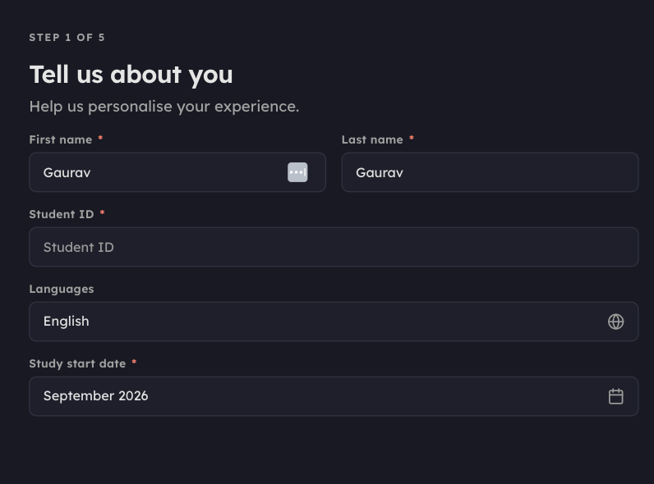
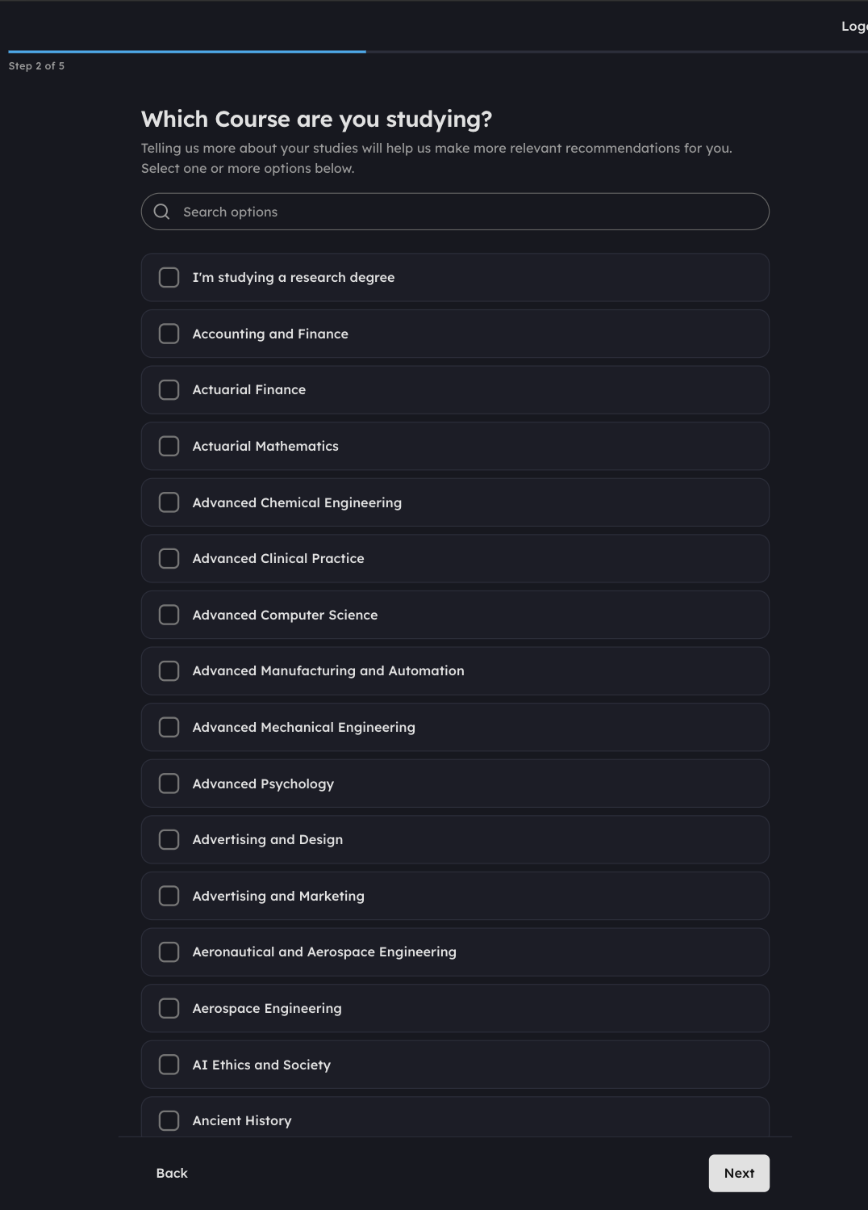
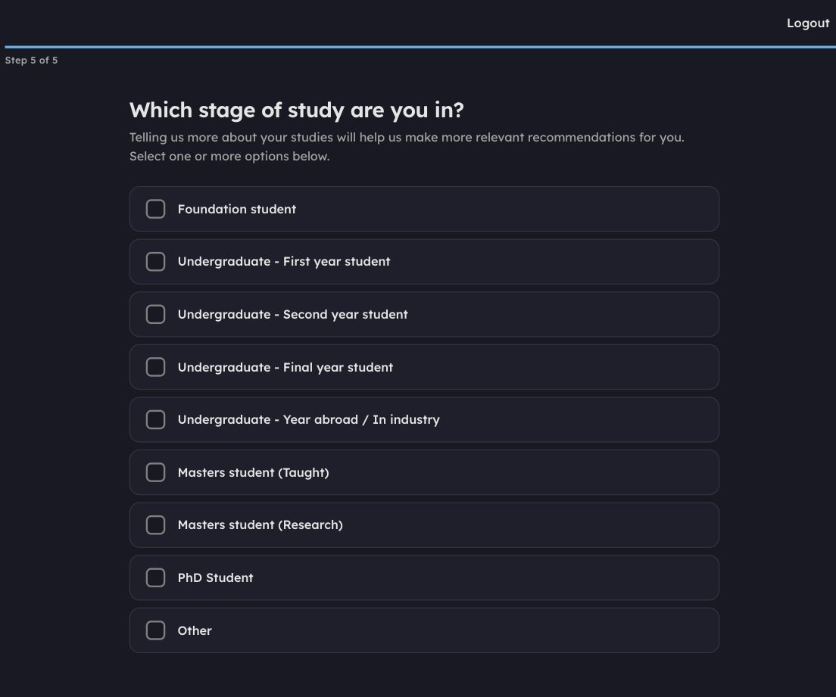
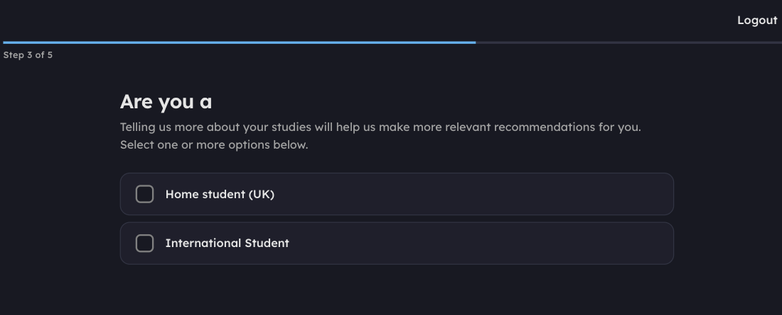
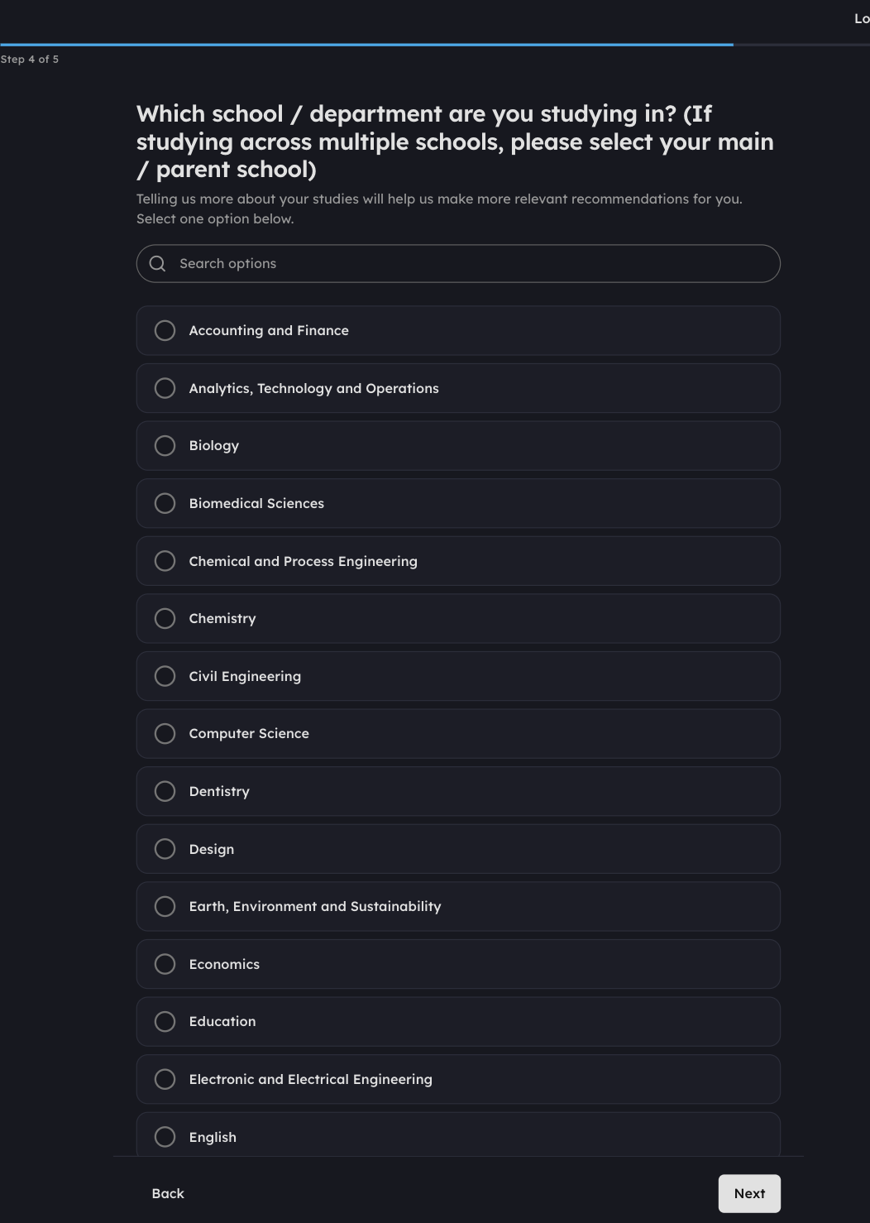
STEP 1 OF 6
01
STEP 1
STEP 2
STEP 3
STEP 4
STEP 5
Confirm your name and student ID
Which course are you studying?
Which stage are you in?
Are you an International or Home Student?
Please select your faculty
Create your Vygo account
Select register, choose the University of Leeds and enter your login details. Then complete the five steps below.
LUBS Taught Postgraduate Buddy Scheme
02
Notes:
Register with the University of Leeds, then five short onboarding steps.

Slide 3
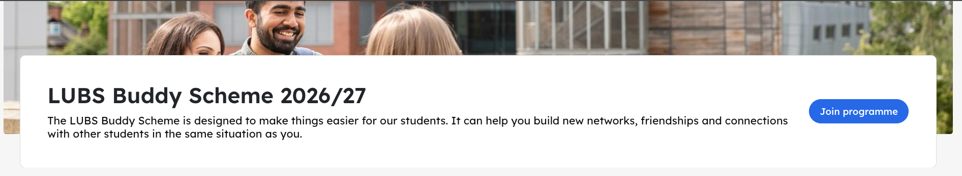
STEP 3 OF 6
Join the LUBS Buddy Scheme 2026/27
The programme will pop up as a recommended programme on your homepage. Enter the programme, select Join programme as a buddy , then answer the join questions.
STEP 1 OF 4
STEP 2 OF 4
STEP 3 OF 4
STEP 4 OF 4
Programme guidelines
Please select some of your hobbies and interests
What are you hoping to find by joining the Buddy Scheme?
Is there anything you’d like us to consider when finding you a match?
Read the Participant Agreement, then click Acknowledge.
Select all options that apply, from Art / Photography through to Vegan / vegetarianism.
Select all that apply — someone to study with, career benefits, a new friend, people from a similar or different culture.
A brief response, max 200 characters. Only admins see this. Then click Join programme.
Once submitted you will see a welcome screen confirming you have joined. Click Continue to programme to finish.
LUBS Taught Postgraduate Buddy Scheme
05
Notes:
Programme appears as a recommendation. Enter it, join as a buddy, answer the four join questions.

Slide 4
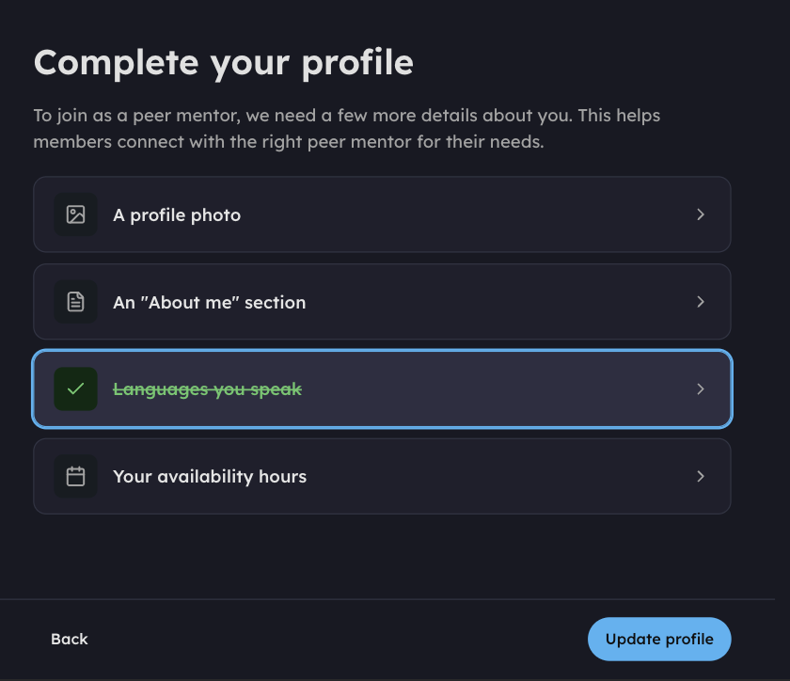
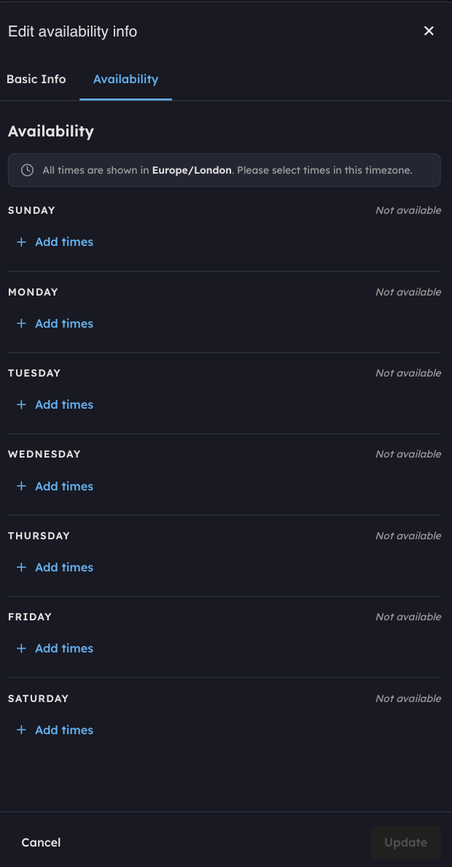
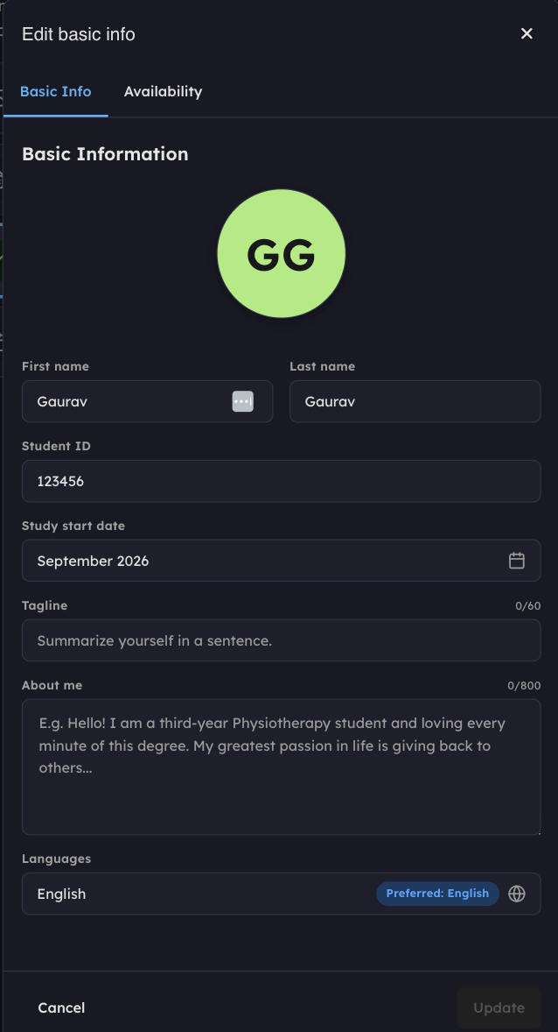
STEP 2 OF 6
Complete your profile
Open each item from the Complete your profile list.
Basic Info holds your photo, tagline, About me and languages.
Availability sets the times you are free for sessions.
Complete your profile before joining the programme. Go to the bottom left corner of your screen, click the area showing your name, then click profile to edit it.
Upload a selfie as your profile picture, or any placeholder image.
Complete your “About me” section, including relevant experience, and let your personality come across.
Select any languages you speak.
Add the times you are available for students to book sessions with you on Vygo.
Record an intro video so others can learn more about you.
LUBS Taught Postgraduate Buddy Scheme
03
Notes:
Complete the profile before joining the programme. Photo, About me, languages, availability, optional intro video.

Slide 5
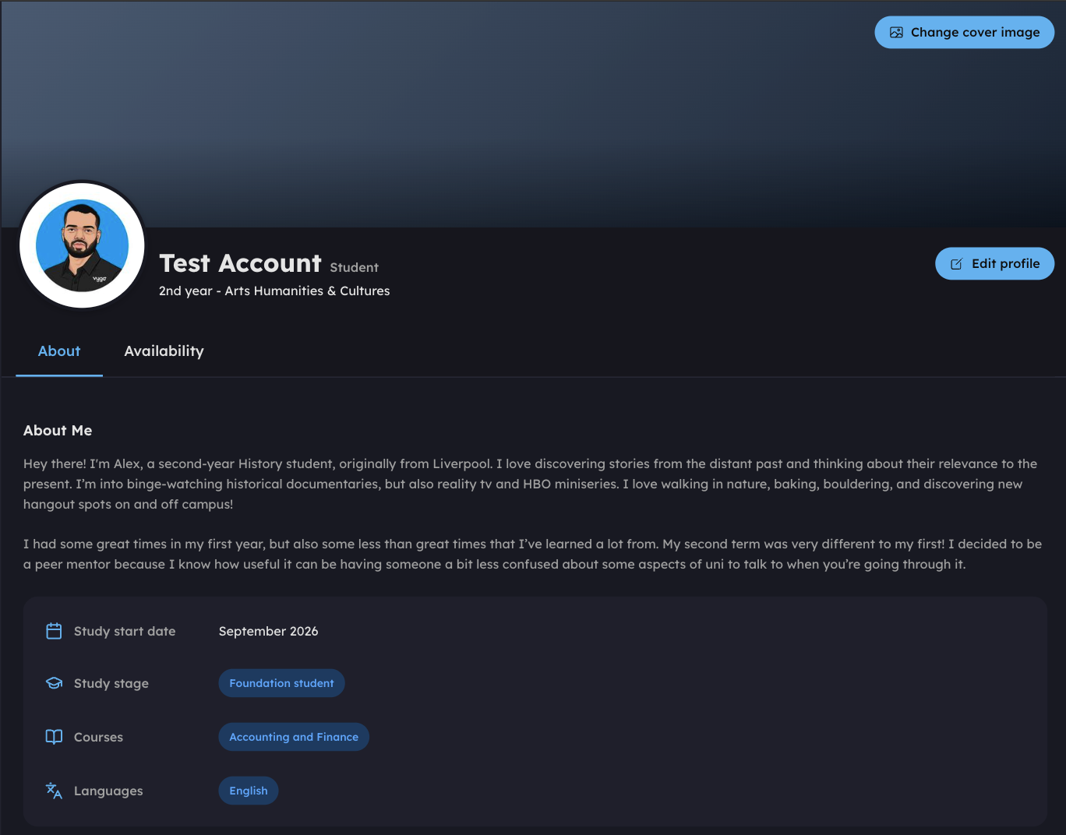
STEP 2 OF 6
Your finished profile
Once completed, your profile will look something like this.
Change anything later from the settings under your account, or with the Edit profile button. You can add more details, such as an intro video, at any point.
If you make any changes, click Save changes when you are done.
LUBS Taught Postgraduate Buddy Scheme
04
Notes:
Remind buddies to save changes after editing.

Slide 6
STEP 4 OF 6
The matching process
Once you have been matched, you will receive a notification by email, and a chat will appear with the person you have been paired with.
PHASE 1
PHASE 2
PHASE 3
Sign up
Matching
Get started
Log in and visit your chat page. Follow the steps in this guide to complete your profile.
We hope to match you to a buddy.
As soon as you know who your buddy is, you can start chatting.
Any queries?
Email s.l.gent@leeds.ac.uk with any queries or concerns.
LUBS Taught Postgraduate Buddy Scheme
06
Notes:
Sign up w/c 20 October, matches w/c 2 November. Queries to s.l.gent@leeds.ac.uk.

Slide 7

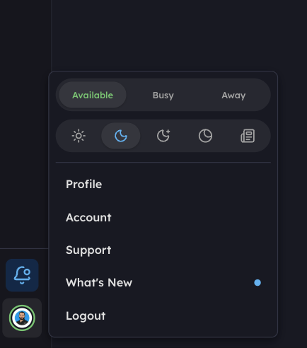
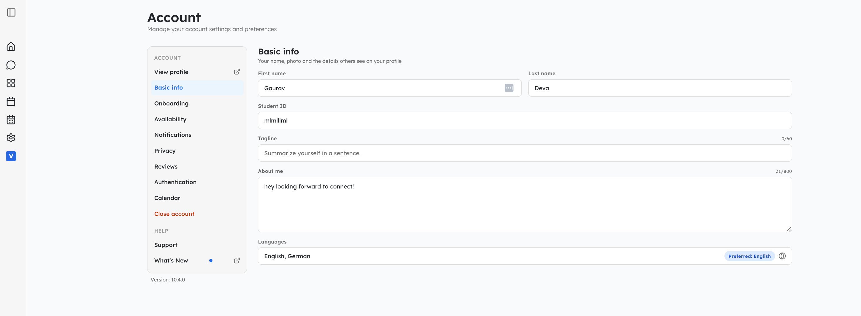
STEP 5 OF 6
Managing your account
Your profile area, bottom left.
Status and account menu.
Click your profile area in the bottom left corner to manage your account. Whenever you log in you land on your Dashboard, which summarises and links to your chats, sessions and events.
OUR RECOMMENDATION
Connect your calendar, so unavailable times are blocked out and booked sessions appear in your usual calendar.
The Account page and its sections.
You can also control your email and app push notifications here. Set your Status to Busy or Away when you cannot talk to your connections; otherwise leave yourself Available.
LUBS Taught Postgraduate Buddy Scheme
07
Notes:
Profile area is bottom left. Connect your calendar, control notifications, set your status.

Slide 8
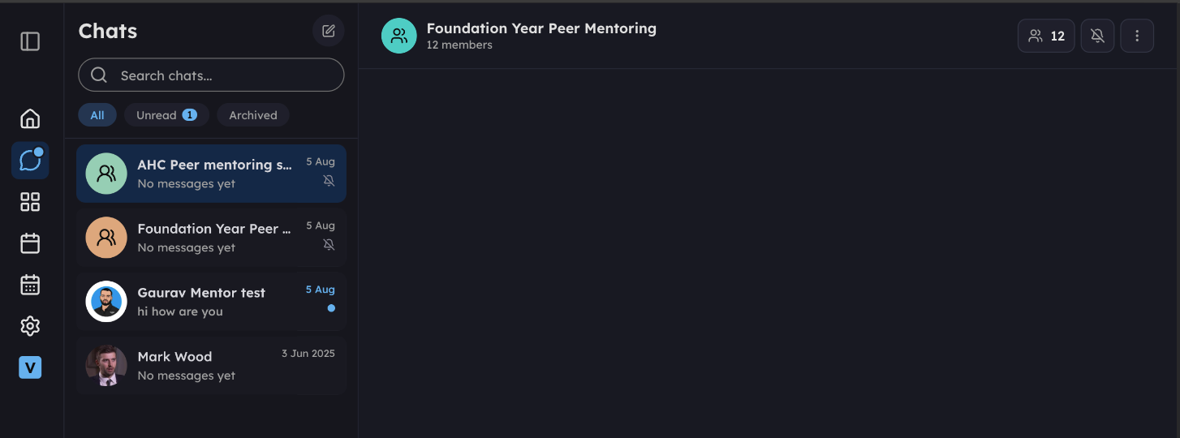
STEP 6 OF 6
06
Communicating on Vygo
Click the Chat icon in the top left to see and message your connections. A blue dot means something is unread.
Flick between chats on the left, read in the large pane, and write in the box at the bottom.
Attach files, format text and use emojis, if that is your style.
View your connection’s profile in the top right, or book a session whenever you are ready. Your buddy can do the same on their side.
LUBS Taught Postgraduate Buddy Scheme
08
Notes:
Chats: unread dot, chat list, attachments, book a session from the profile.

